Slide 1
Manganese Guideline
Stacey Sowa, Drinking Water Coordinator
Island Health
November 17, 2022
Stacey Sowa, Drinking Water Coordinator
Island Health
November 17, 2022
Excellent health and care for everyone, everywhere, every time.

Slide 2
Outline
Background
Why do we care?
Guidance and Resources
Action Plan
Communication
Sampling and Monitoring
Mitigation Options
Distribution Management
Challenges
What is Island Health doing?
Questions

Slide 3
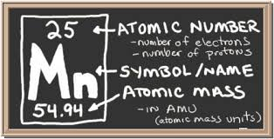
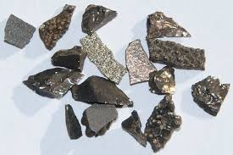
Background
What is Manganese (Mn)?
Chemical element #25
Heavy metal
What is Mn used for?
Alloys (i.e. steel)
Batteries
Drinking Water Treatment
Human body functions
Source: chem4kids.com
Source: https://www.mindat.org/element/Manganese

Slide 4
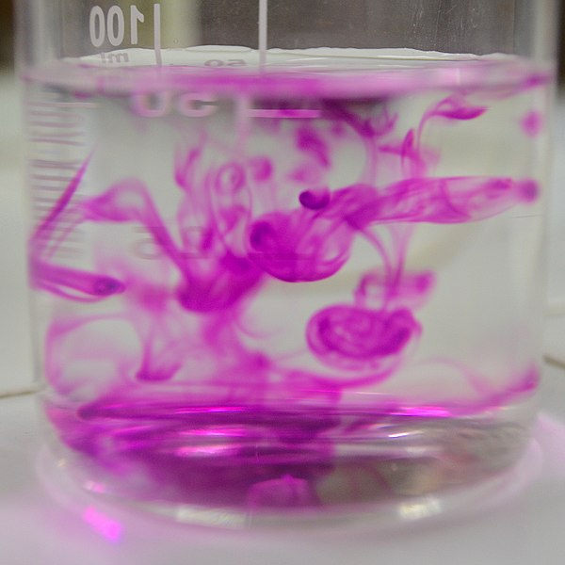
Background
Where might we interact with Mn in our environment?
Naturally occurring in environment
Food
Anthropogenic sources (i.e. industry, mining)
Water treatment additives
Source: https://commons.wikimedia.org/wiki/File:Effect_of_drops_of_KMnO4_in_water.jpg

Slide 5
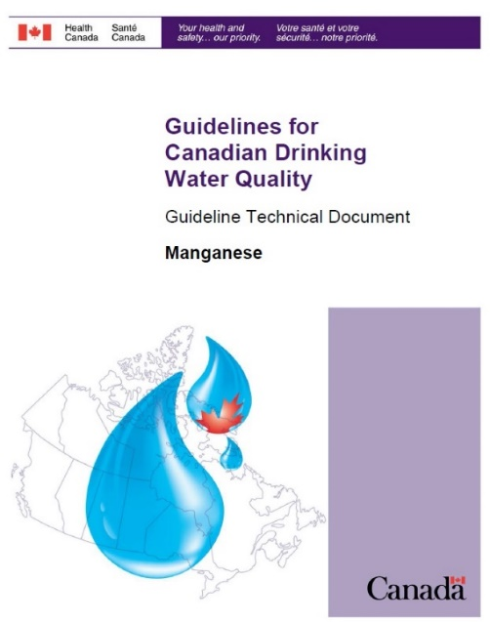
Background
Guidelines for Canadian Drinking Water Quality:
Pre-2019 – AO only
2019 – New limits set:
AO – 0.02mg/L
MAC – 0.120mg/L

Slide 6
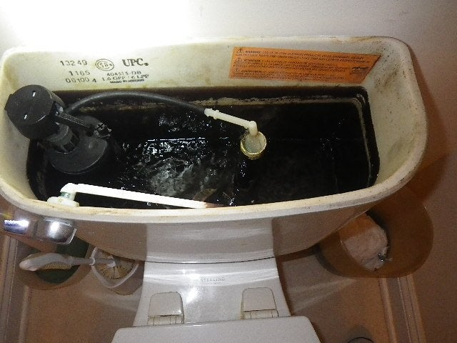
Why do we care?
Health Impacts:
Neurological effects in children
Infants most impacted
- No studies currently link Mn to cancer
Other Impacts:
- Mn can cause:
Staining of fixtures
Discoloured water
Taste and odor issues
Source: https://www.reddit.com/r/HomeImprovement/comments/3d79q6/severe_manganeseiron_staining_in_prospective_house/

Slide 7
Why do we care?
Additional health impact considerations:
Water entering distribution with levels exceeding 0.015mg/L
Other heavy metals
Mn is an “effective scavenger and sink”

Slide 8
Guidance and Resources
Health Canada - Guidelines for Canadian Drinking Water Quality: Guideline Technical Document – Manganese
Ministry of Health – Guidance on Manganese in Drinking Water
HealthLink BC – Manganese in Drinking Water

Slide 9
Action Plan: Communication
Communication
Communication is key
What are the risks?
What should the user do?
What are you doing?
Let your DWO know.
Transparency!!!

Slide 10
Action Plan: Sampling and Monitoring
Initial screening
Source
Water entering distribution
Distribution
Routine monitoring
Quarterly
Recommend arsenic and lead included

Slide 11
Action Plan – Mitigation Options
Blending
Oxidation, flocculation/coagulation, and filtration
Adsorption
Softening and Ion Exchange
Distribution Management

Slide 12
Action Plan – Distribution Management
Monitoring
Identify Key Areas
Routine
Quarterly
Ad-hoc
Post-flushing
Complaint Driven
Stable Water Chemistry
Minimizes release from settled accumulations
Minimize disturbances
Flushing
Pros and cons

Slide 13
Action Plan - Challenges
Available system information
Financial
Cost to system
Cost to users
Expertise

Slide 14
What is Island Health doing?
Identified water systems with exceedances
Launched Communication to affected systems
October 2022

Slide 15
What is Island Health doing?
Core Requirements:
Communicate to users where distribution exceedances exist
0.300mg/L
Update water quality data
Submit Implementation Plan

Slide 16
What is Island Health doing?
Review and Approval of Implementation Plans:
Case-by-case
Mn levels
Risk level of users (i.e. daycares, schools, etc.)

Slide 17
QUESTIONS??
Stacey Sowa, Drinking Water Program Coordinator, Island Health
stacey.sowa@islandhealth.ca
Contact your DWO
Health Protection Office Locations: https://www.islandhealth.ca/our-locations/health-protection-environmental-services-locations

