Slide 1
3 STEPS to achieving community preparedness
3. Community preparedness
2. Neighbourhood / Work place preparedness
1. Personal Preparedness
You and your loved ones for 7 days

Slide 2
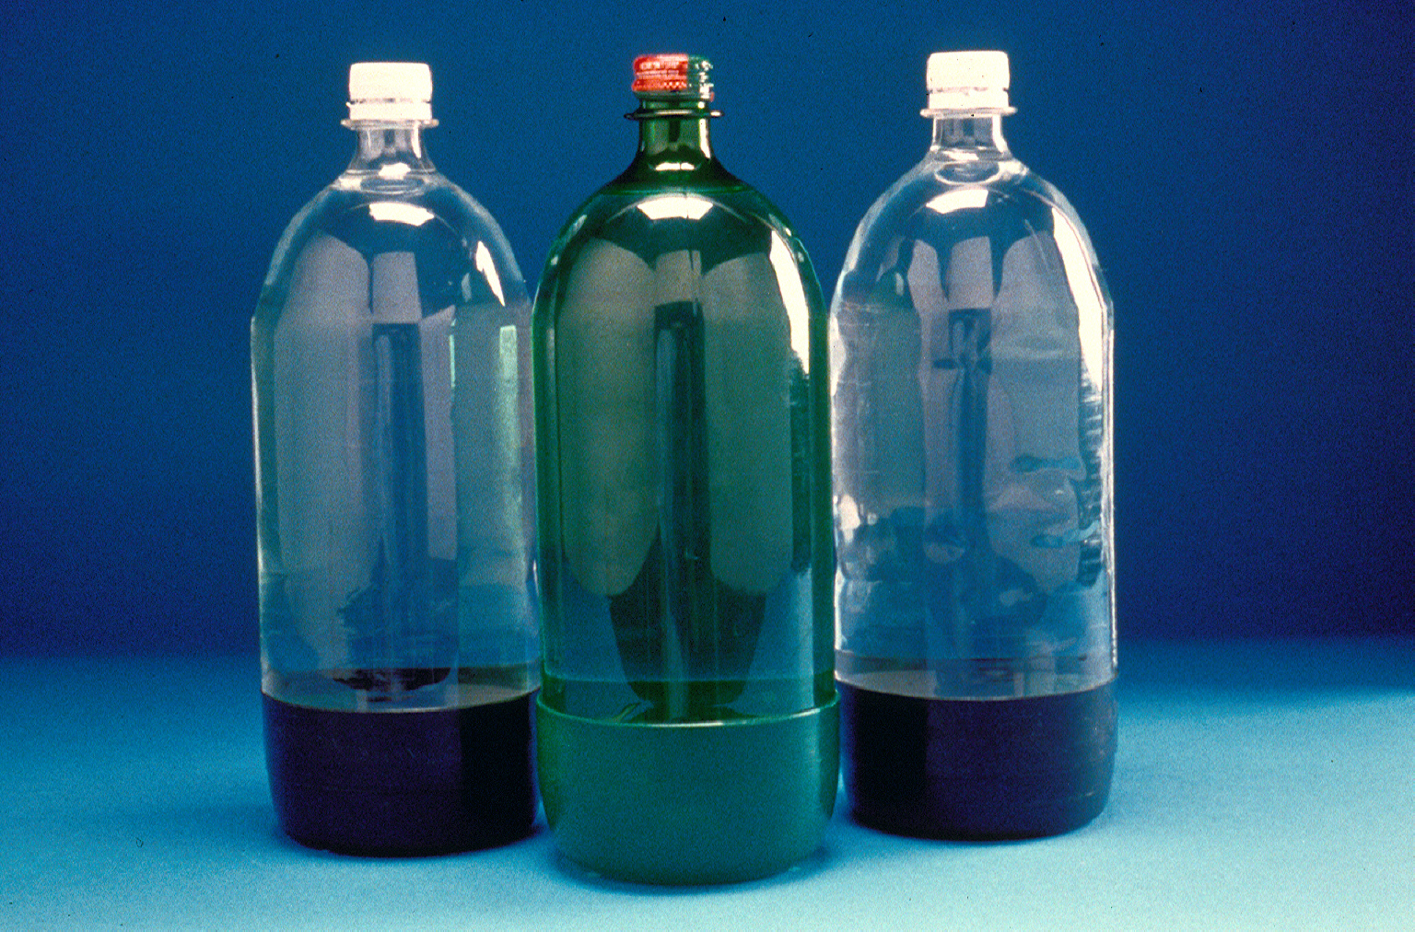
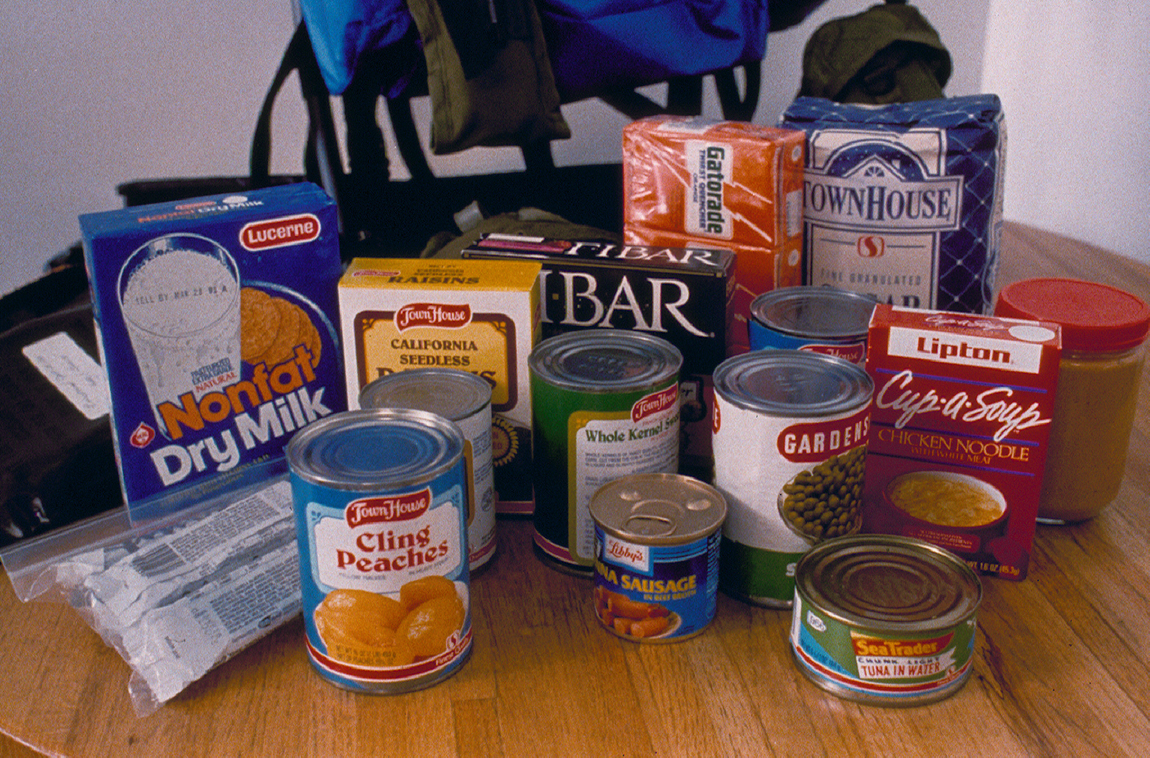
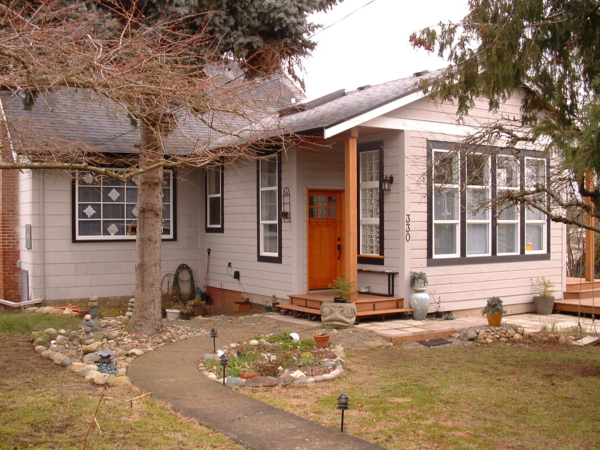
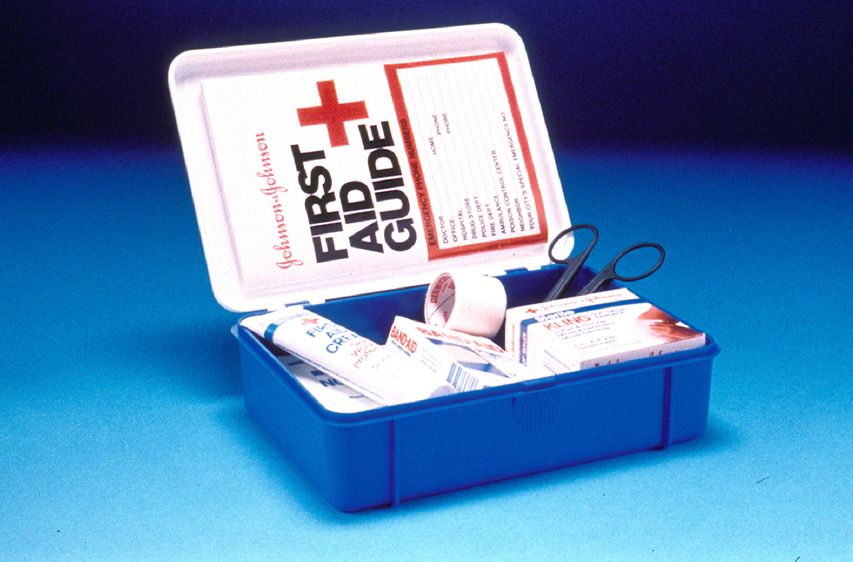
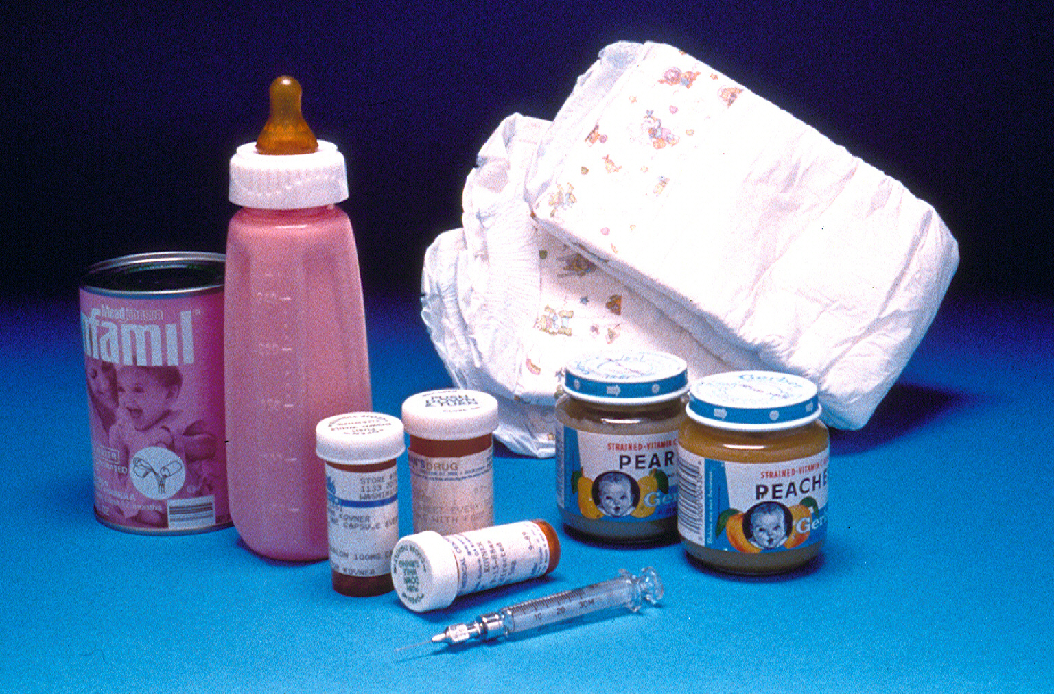
PERSONAL PREPAREDNESS
THE BEAUTIFUL BASICS
1st STEP
Water
Food
Shelter
Special Needs

Slide 3
WORKPLACE
(or)
NEIGHBOURHOOD PREPAREDNESS
2nd STEP
Six Teams Emergency Planning

Slide 4
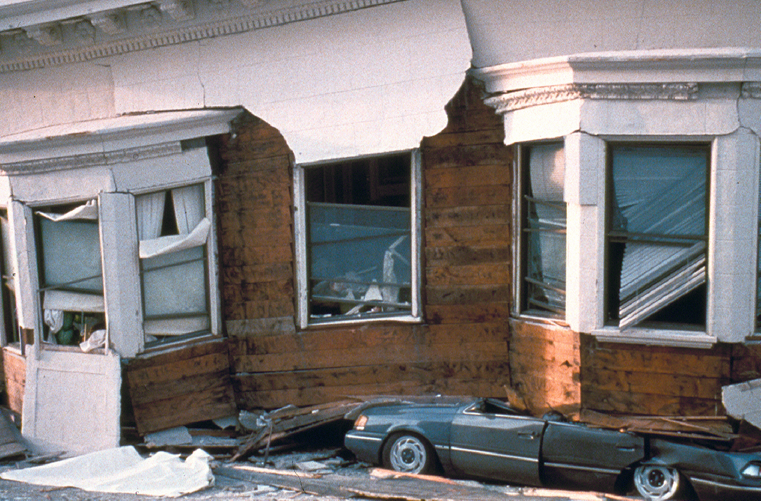
Business or Neighbourhood Program:
Six Teams Emergency Planning
The 6 teams:
Rapid Damage Assessment
Rapid Search & Rescue
Rapid First Aid
Safety and Security
Shelter & Care Giving
Communications

Slide 5
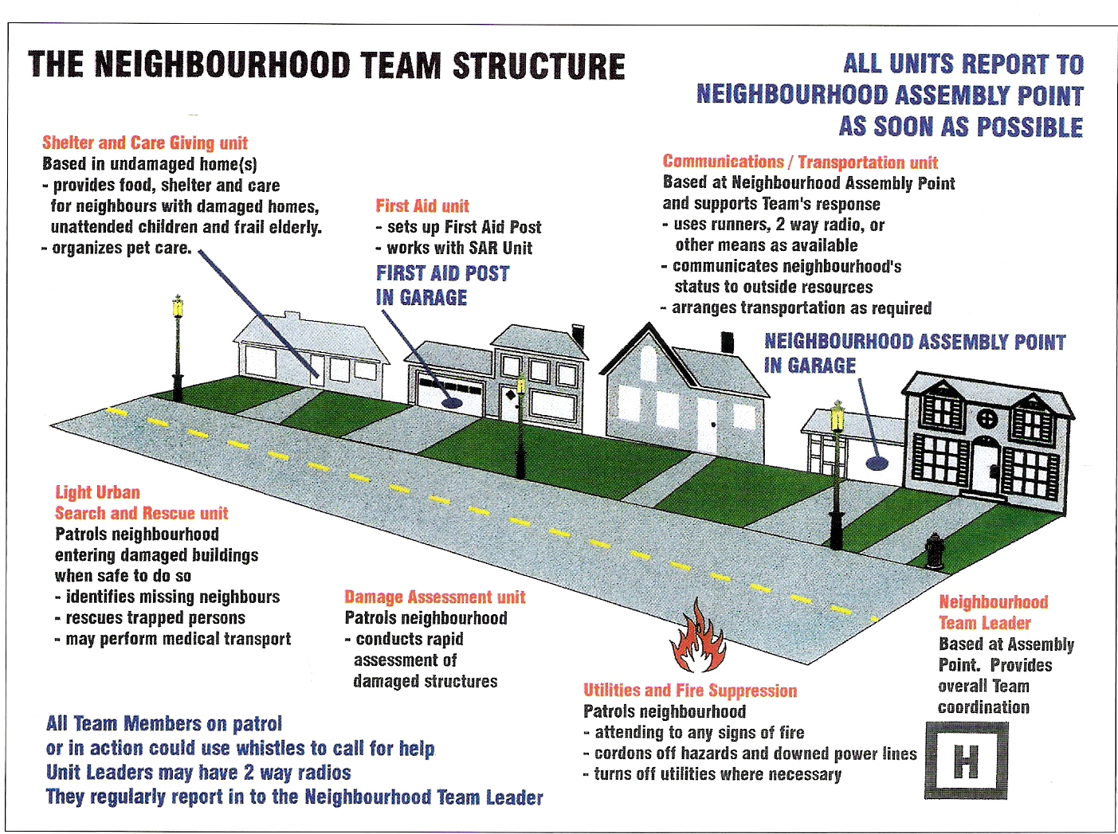
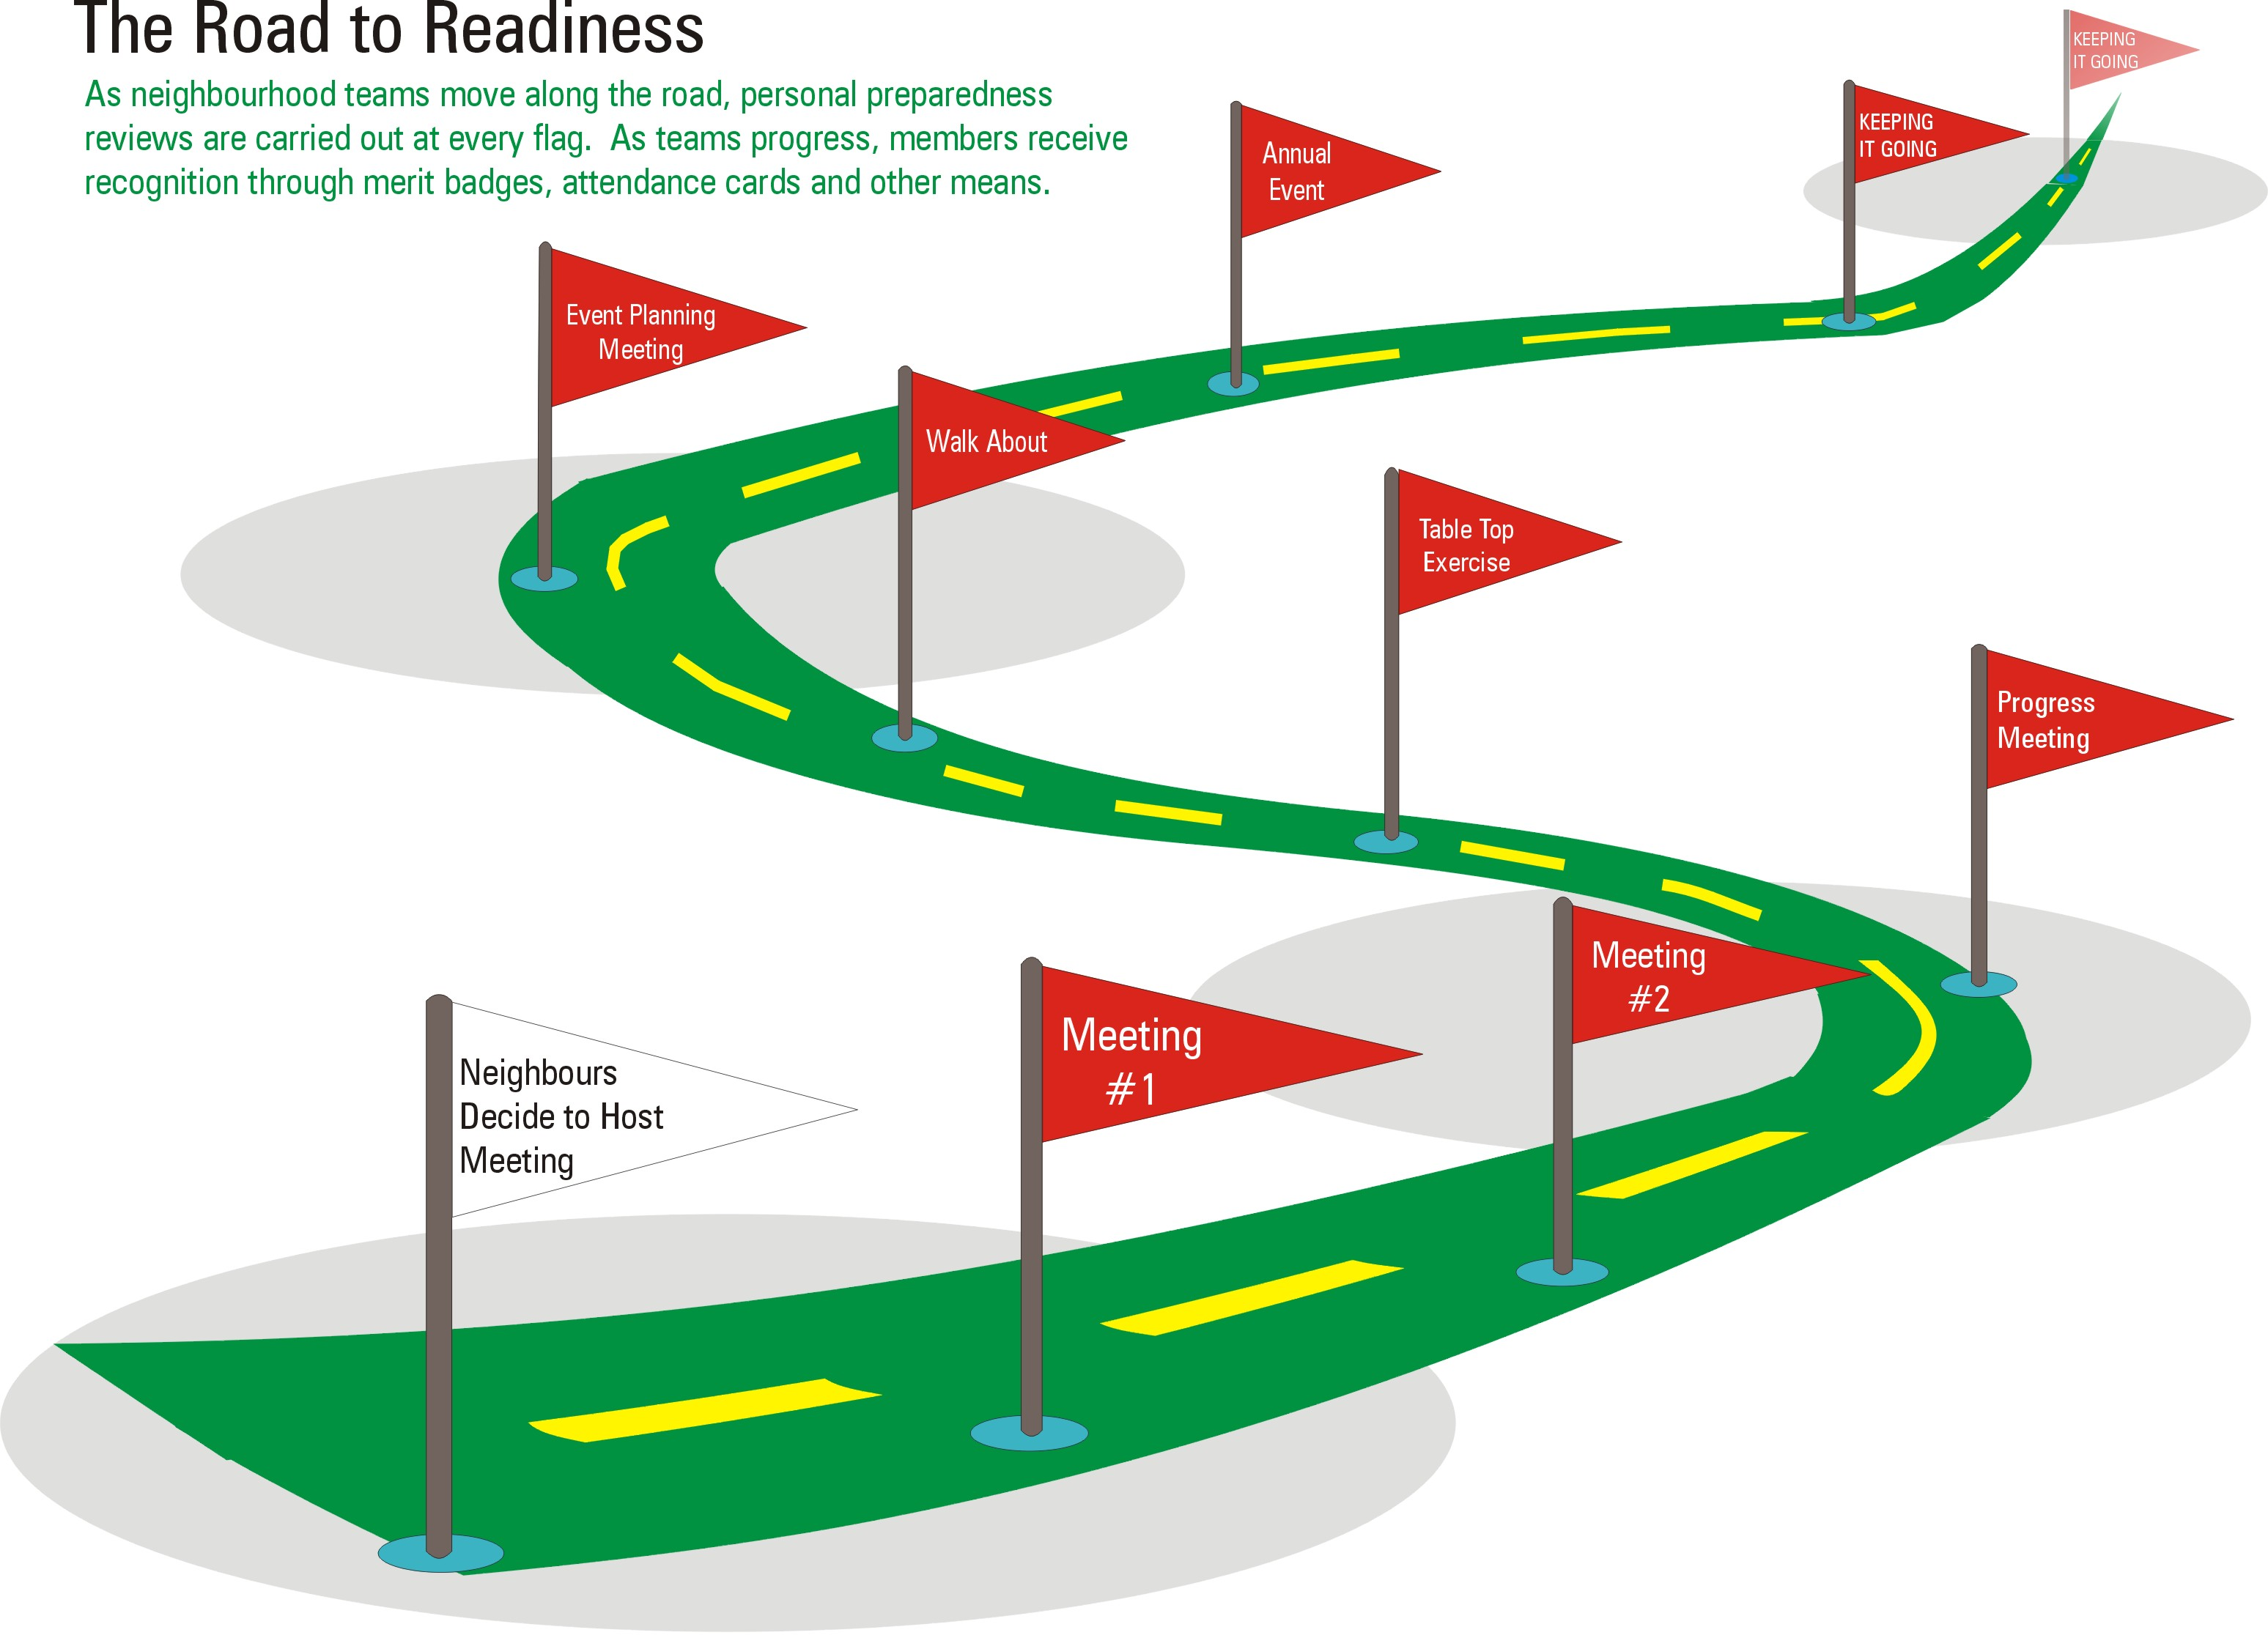
SUCCESSION
THROUGH COMMUNITY INVOLVEMENT
AND SCHOOL EDUCATION PROGRAMS

Slide 6
COMMUNITY PREPAREDNESS
STEP 3
Setup The Emergency Program

Slide 7
CRITICAL INFRASTRUCTURE NATIONAL – PROVINCIAL – LOCAL AUTHORITY
Canada’s critical infrastructure is made up of the facilities, services, assets and information systems that Canadians depend upon for their health, safety, security or economic well-being:
  Energy and utilities (gas, oil and electricity);
  Transportation (air, water, rail or land);
  Communications (tel./cell, internet, satellite, radio and TV);
  Safety (police, fire, ambulance, 911 services and search and rescue nuclear safety, )
  Financial, food and health services (banking, agriculture and food distribution, water treatment and hospitals and pharmaceuticals); and
  Government services (pensions, employment insurance, immigration, weather forecasting and education).
AGING AND EXPENSIVE TO REPAIR AND/OR REPLACE.

Slide 8
CRITICAL INFRASTRUCTURE PROTECTION
EXAMPLE – INTERNET / CYBER NETWORKS
Increasing interconnection and dependencies of systems, use of Internet Protocol systems pervasive
Automated Control Systems, transport systems and databases at Risk
Military systems increasingly ride on and depend on the civil infrastructure
Threat mostly hackers now, but state actors are a distinct possibility
Developed nations the most vulnerable

Slide 9
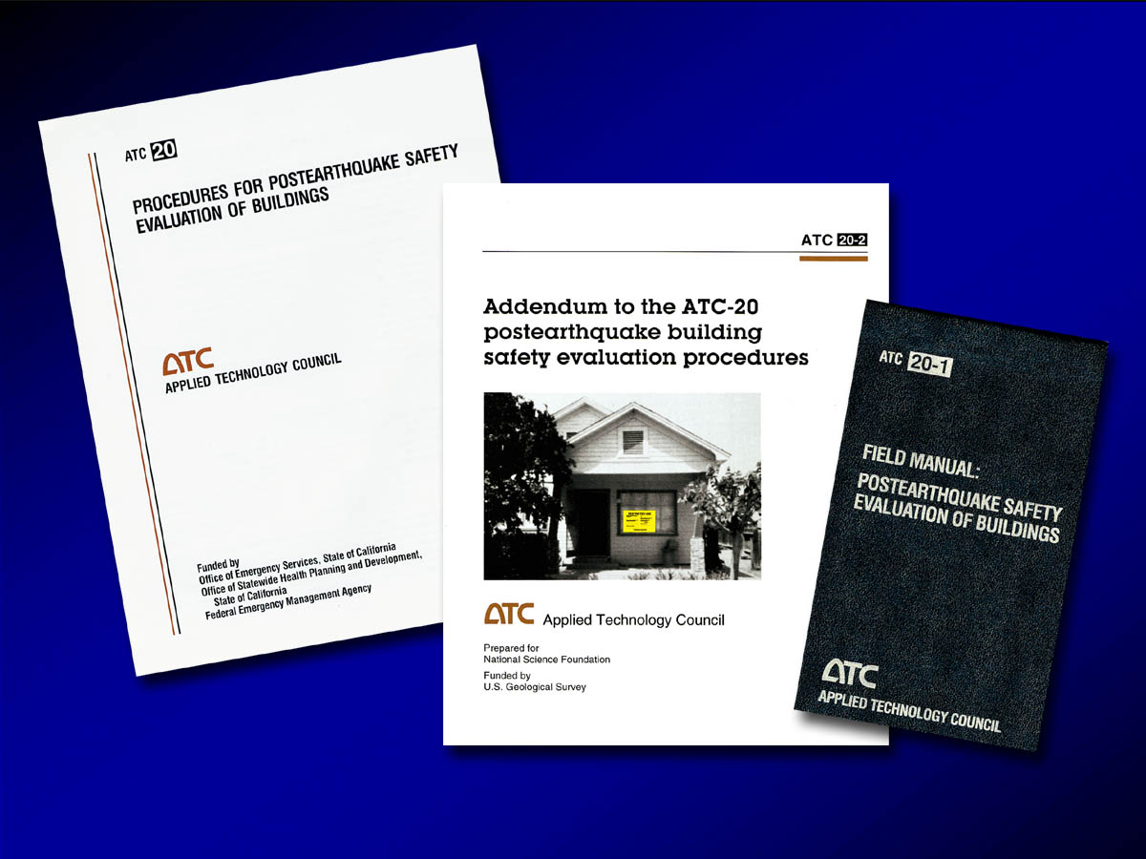
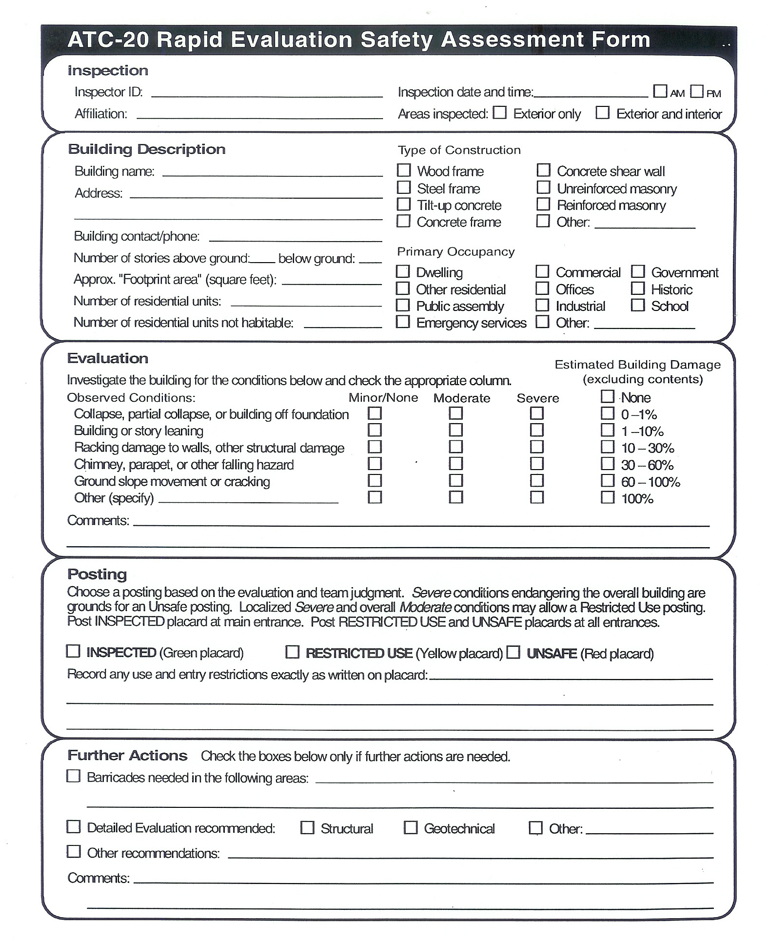
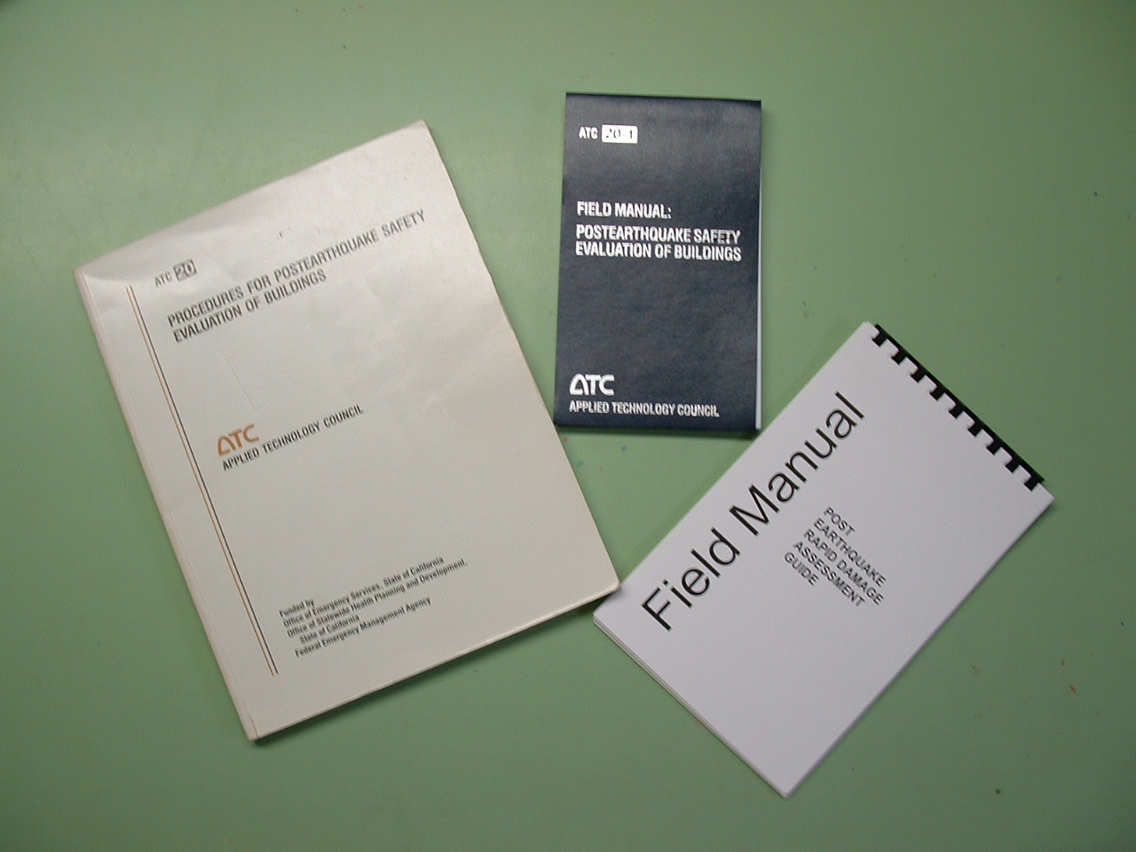
RAPID DAMAGE ASSESSMENT
Field Manual and Forms
ATC – 20 MANUAL
ATC 20-1 Field Manual
Condensed from the ATC 20
MIECM Field Manual
Condensed from the ATC 20

Slide 10
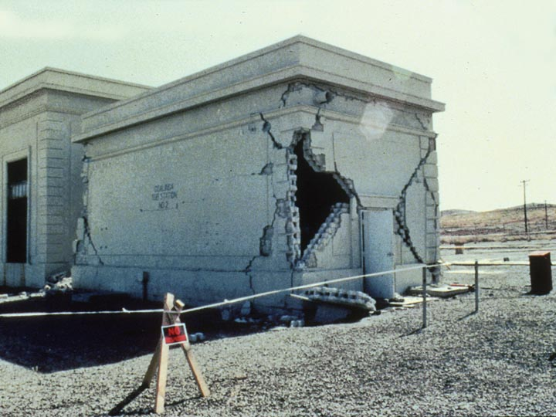
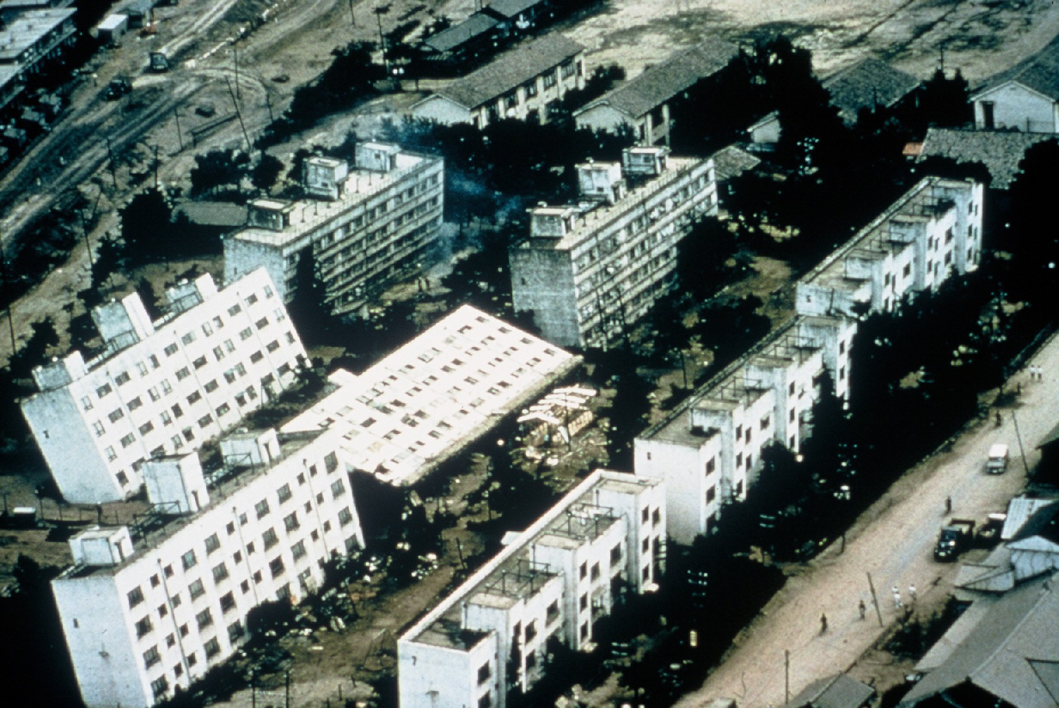
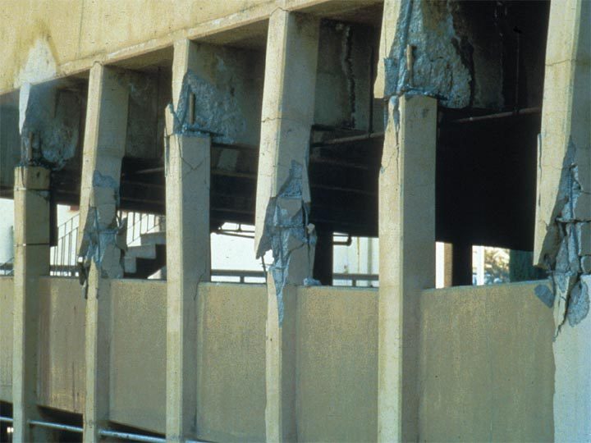
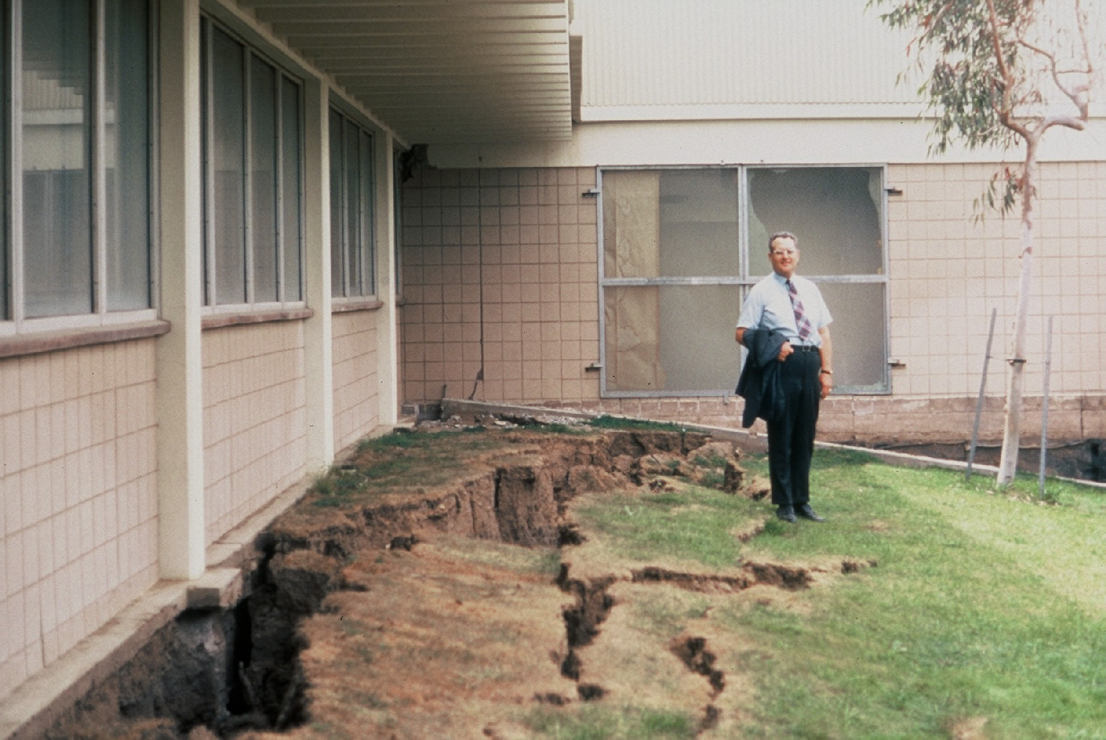
STRUCTURAL COLLAPSE
GEOTECHNICAL DAMAGE
Is this a Principle or an Engineer?

Slide 11
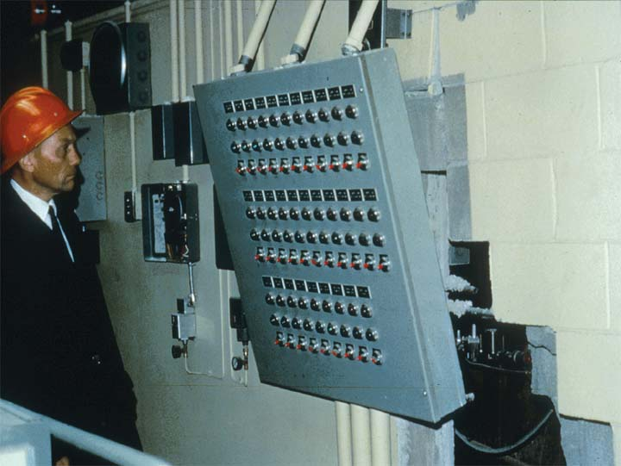
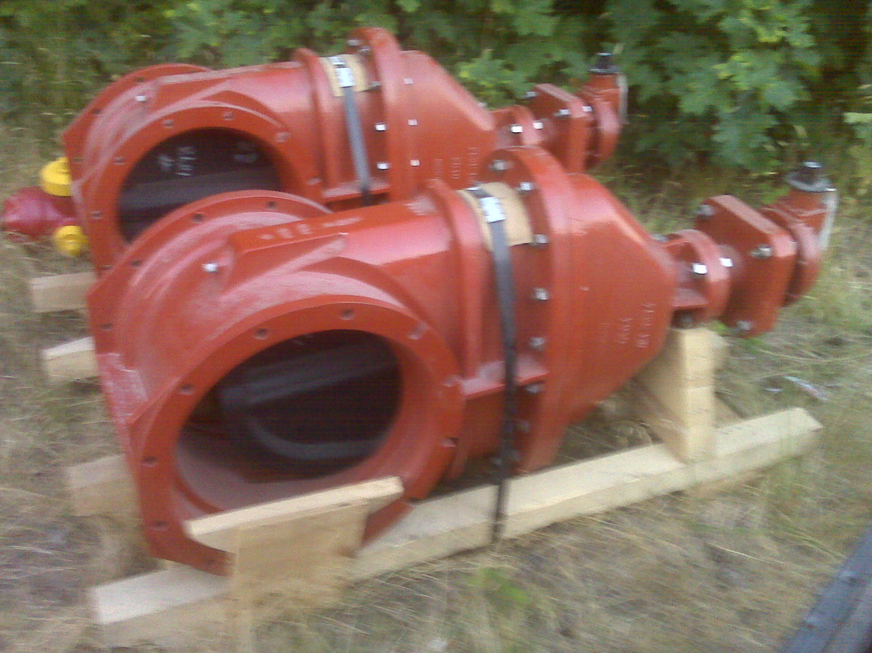
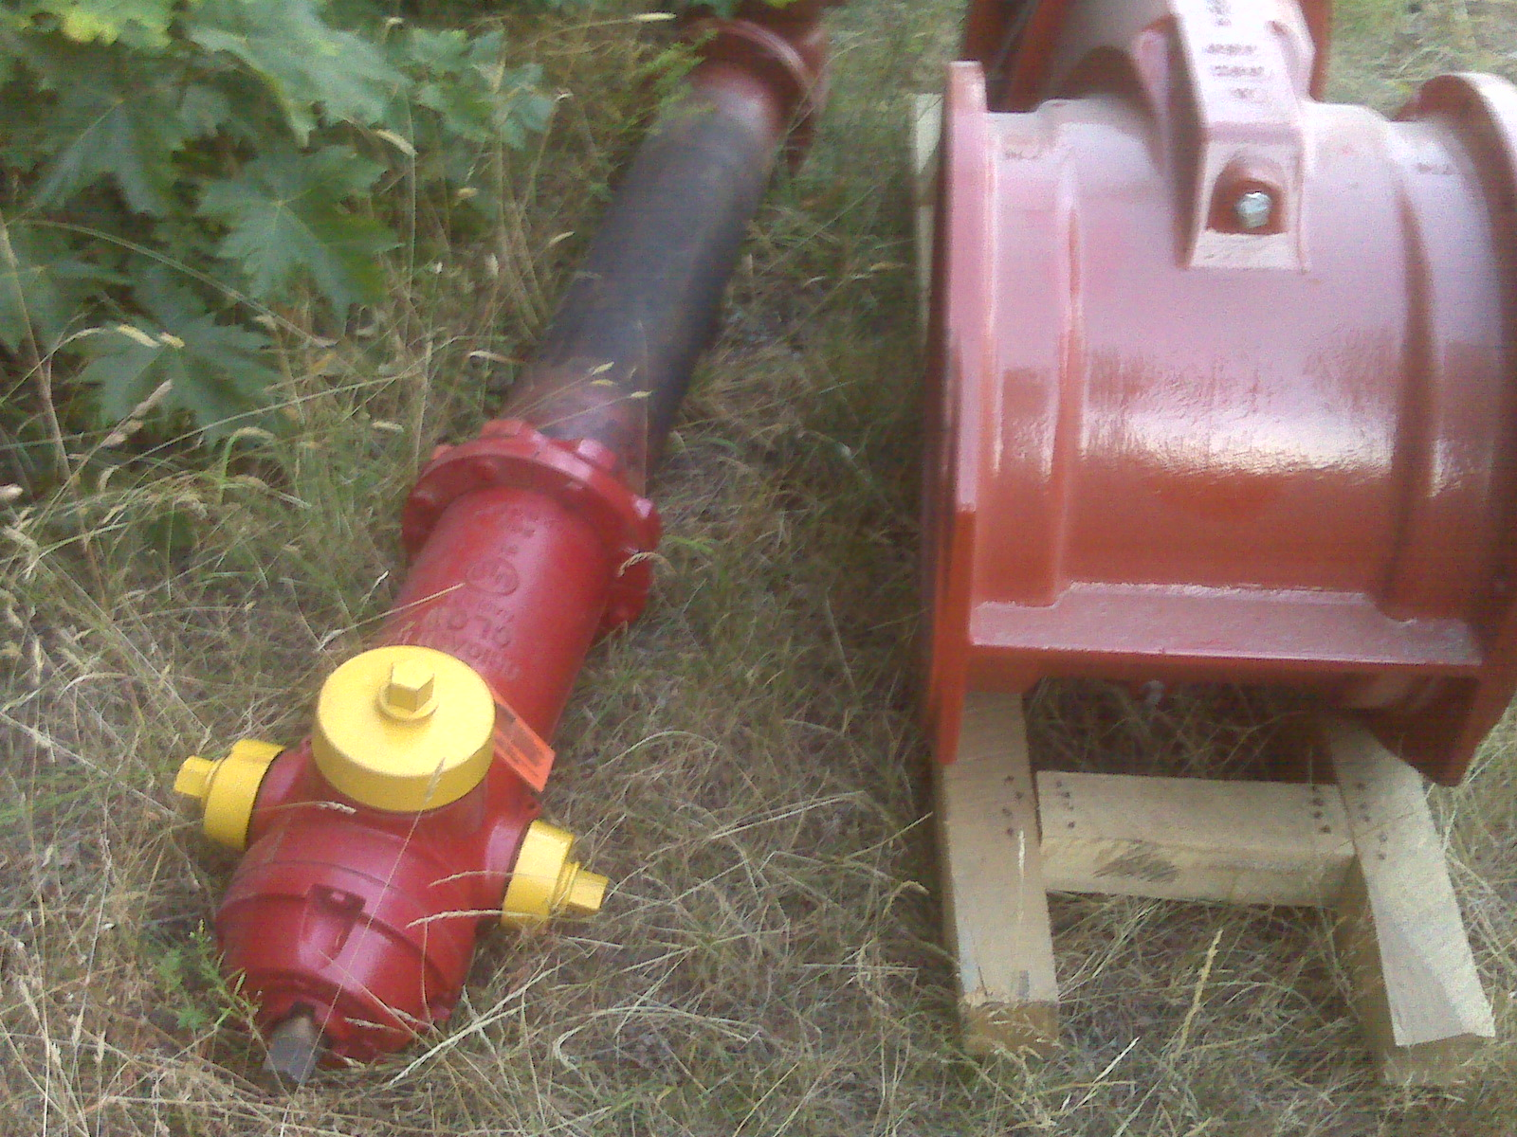
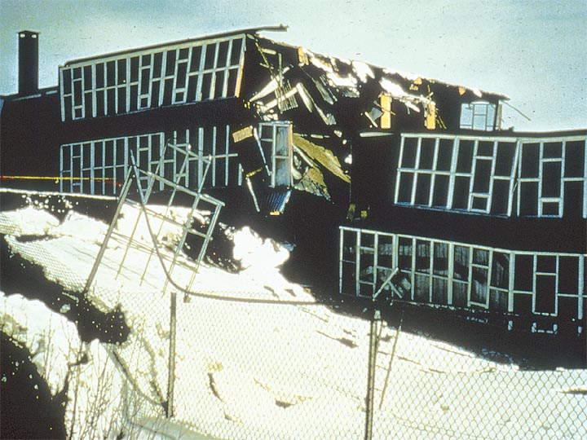
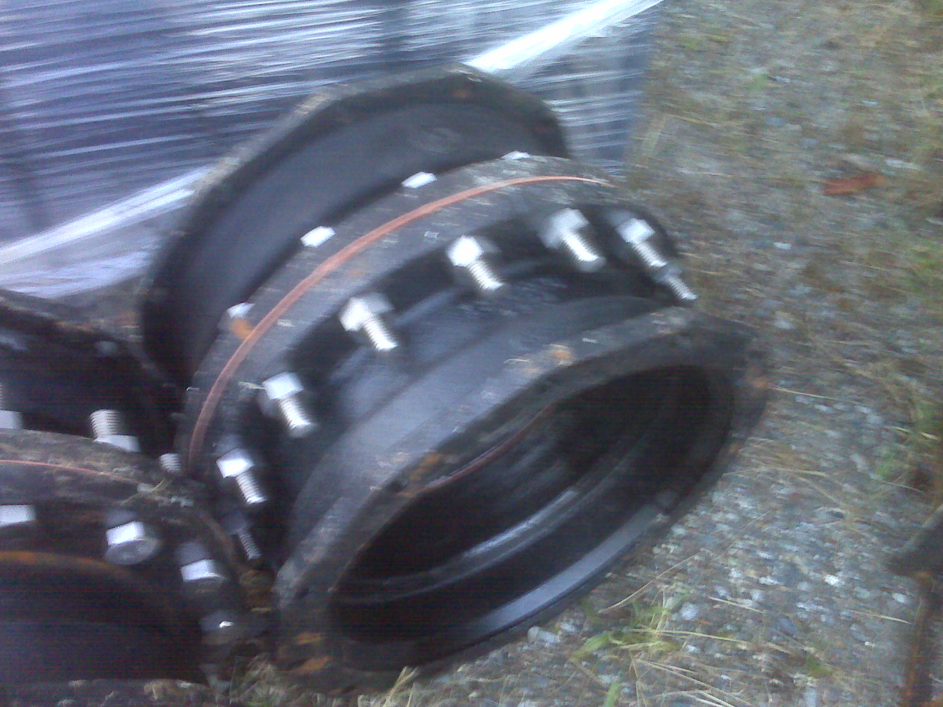
SUPPLY CHAIN MANAGEMENT
OFFSHORE SUPPLIERS?
RECOVERY SUPPLIES AND CRITICAL INFRASTRUCTURE REPLACEMENT?
Notes:
Tall equipment and wall-mounted equipment can be a falling hazard in the event of an aftershock.
Make certain that the anchors holding the equipment to the wall are still intact.
This panel was dislodged due to the failure of the anchor bolts and the failure of the unreinforced block partition wall.

Slide 12
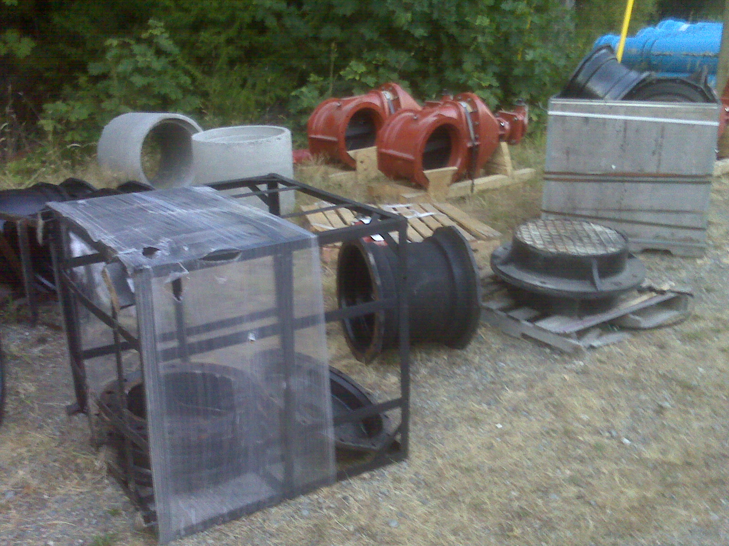
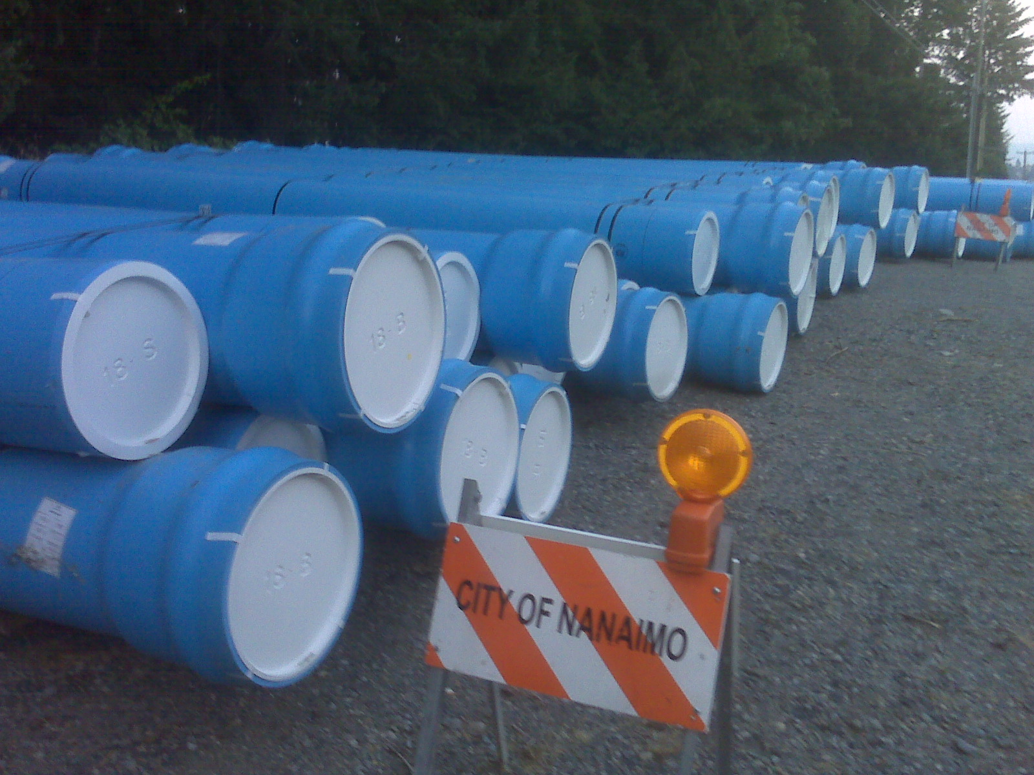
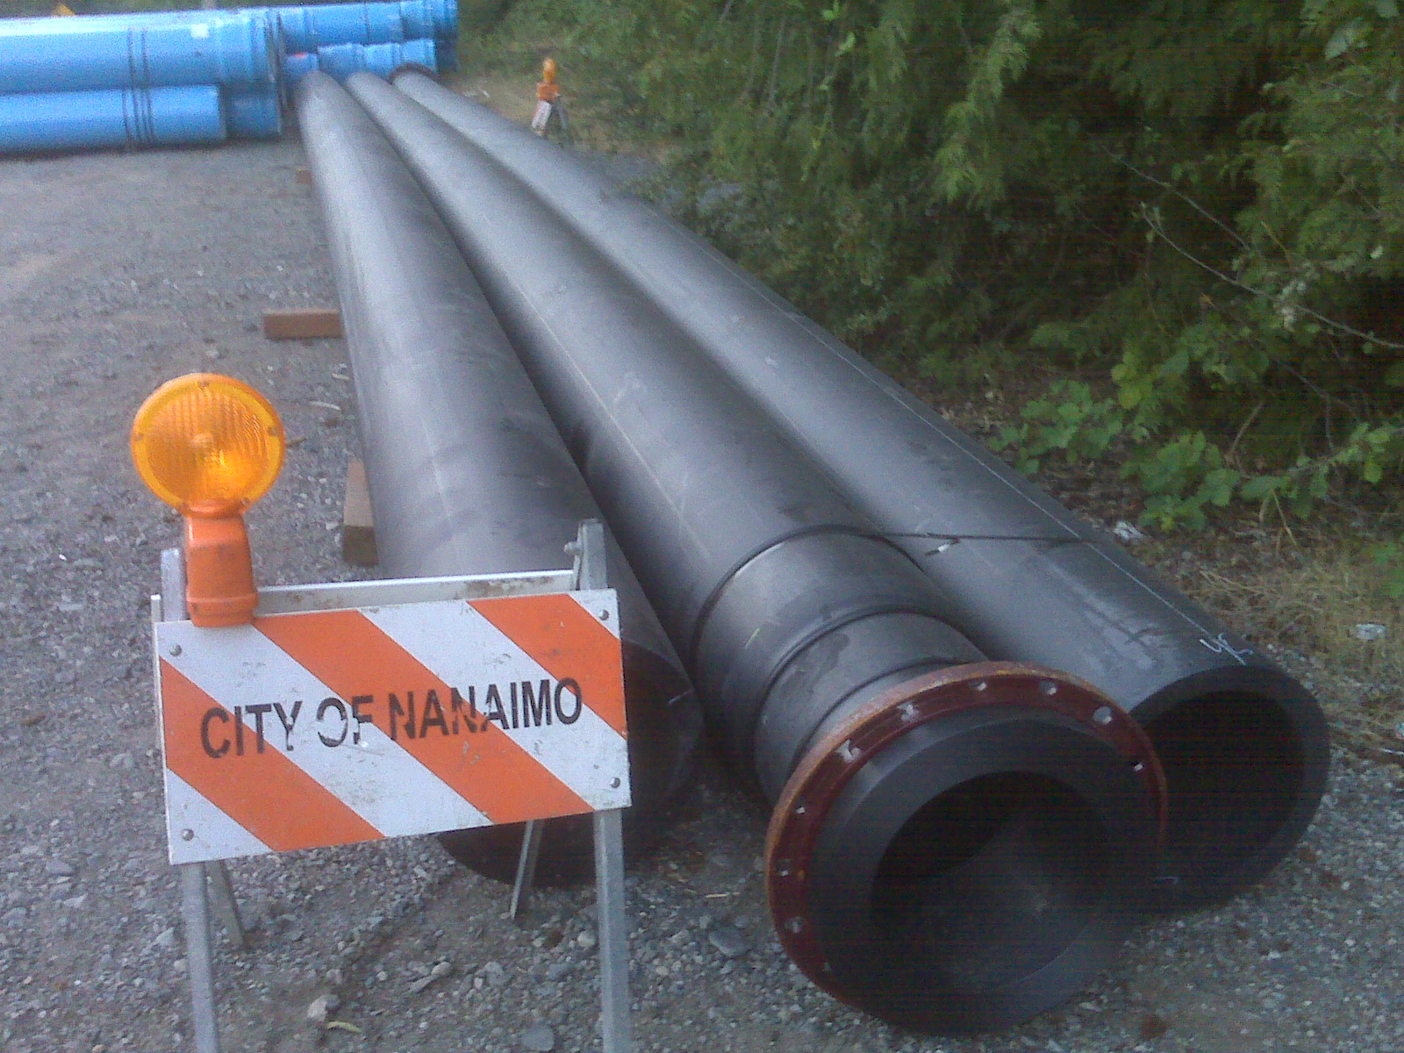
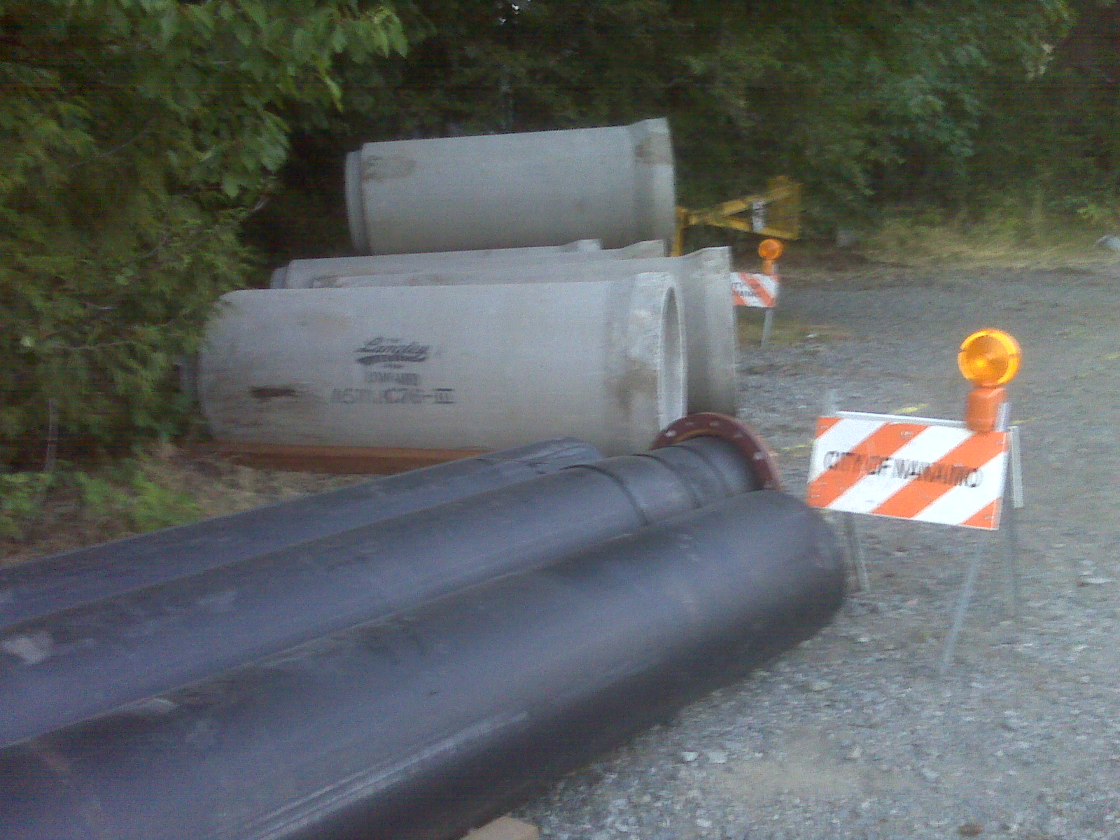
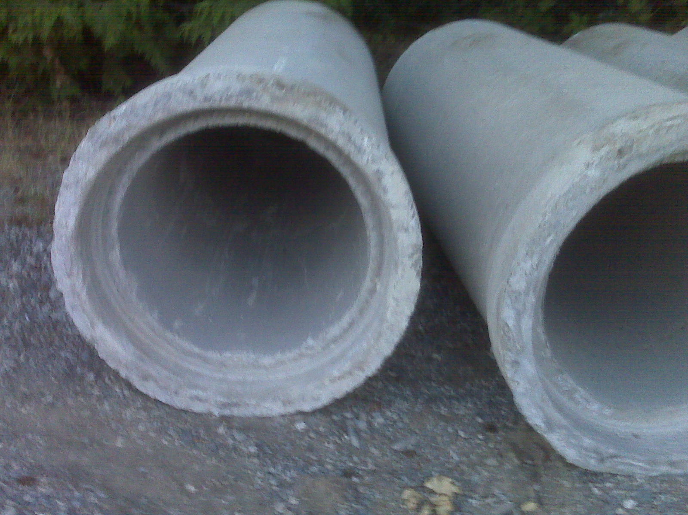
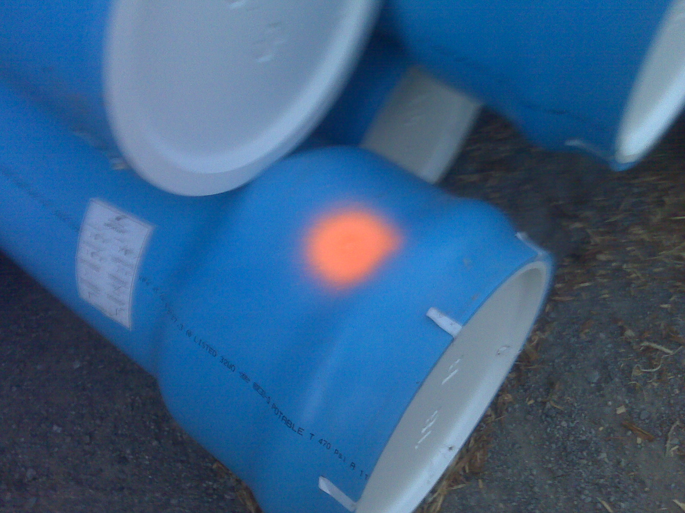
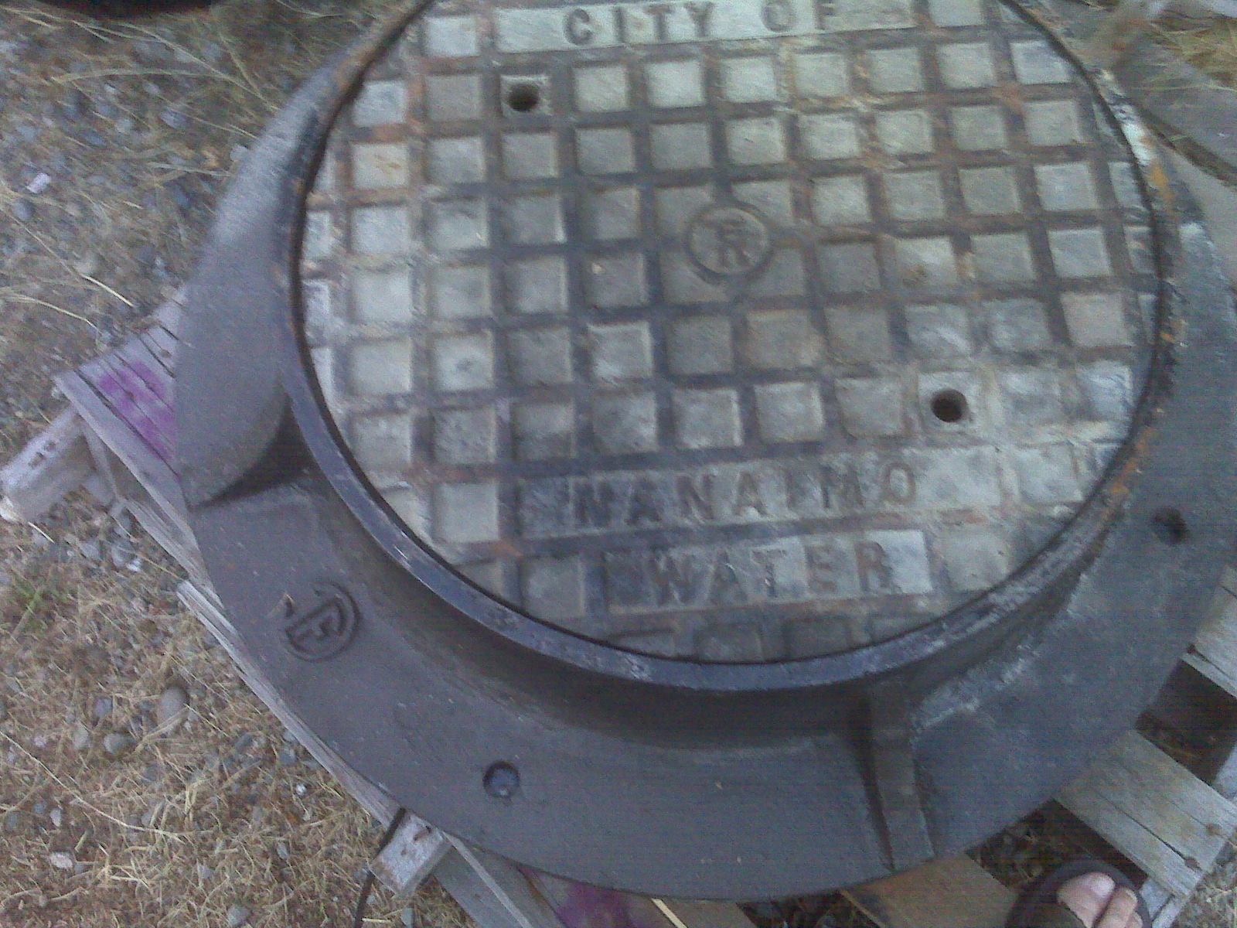
Project-
Transmission Watermain replacement post disaster
When can we ge Product delivery to
????

Slide 13
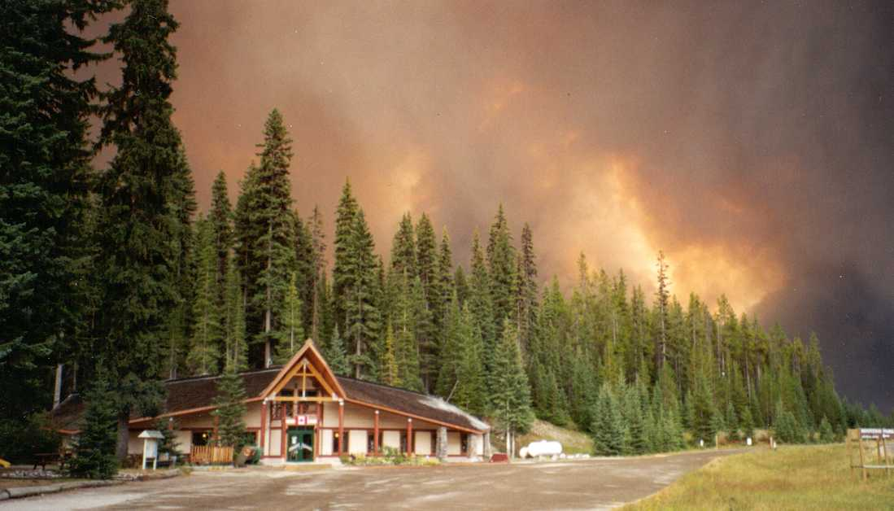

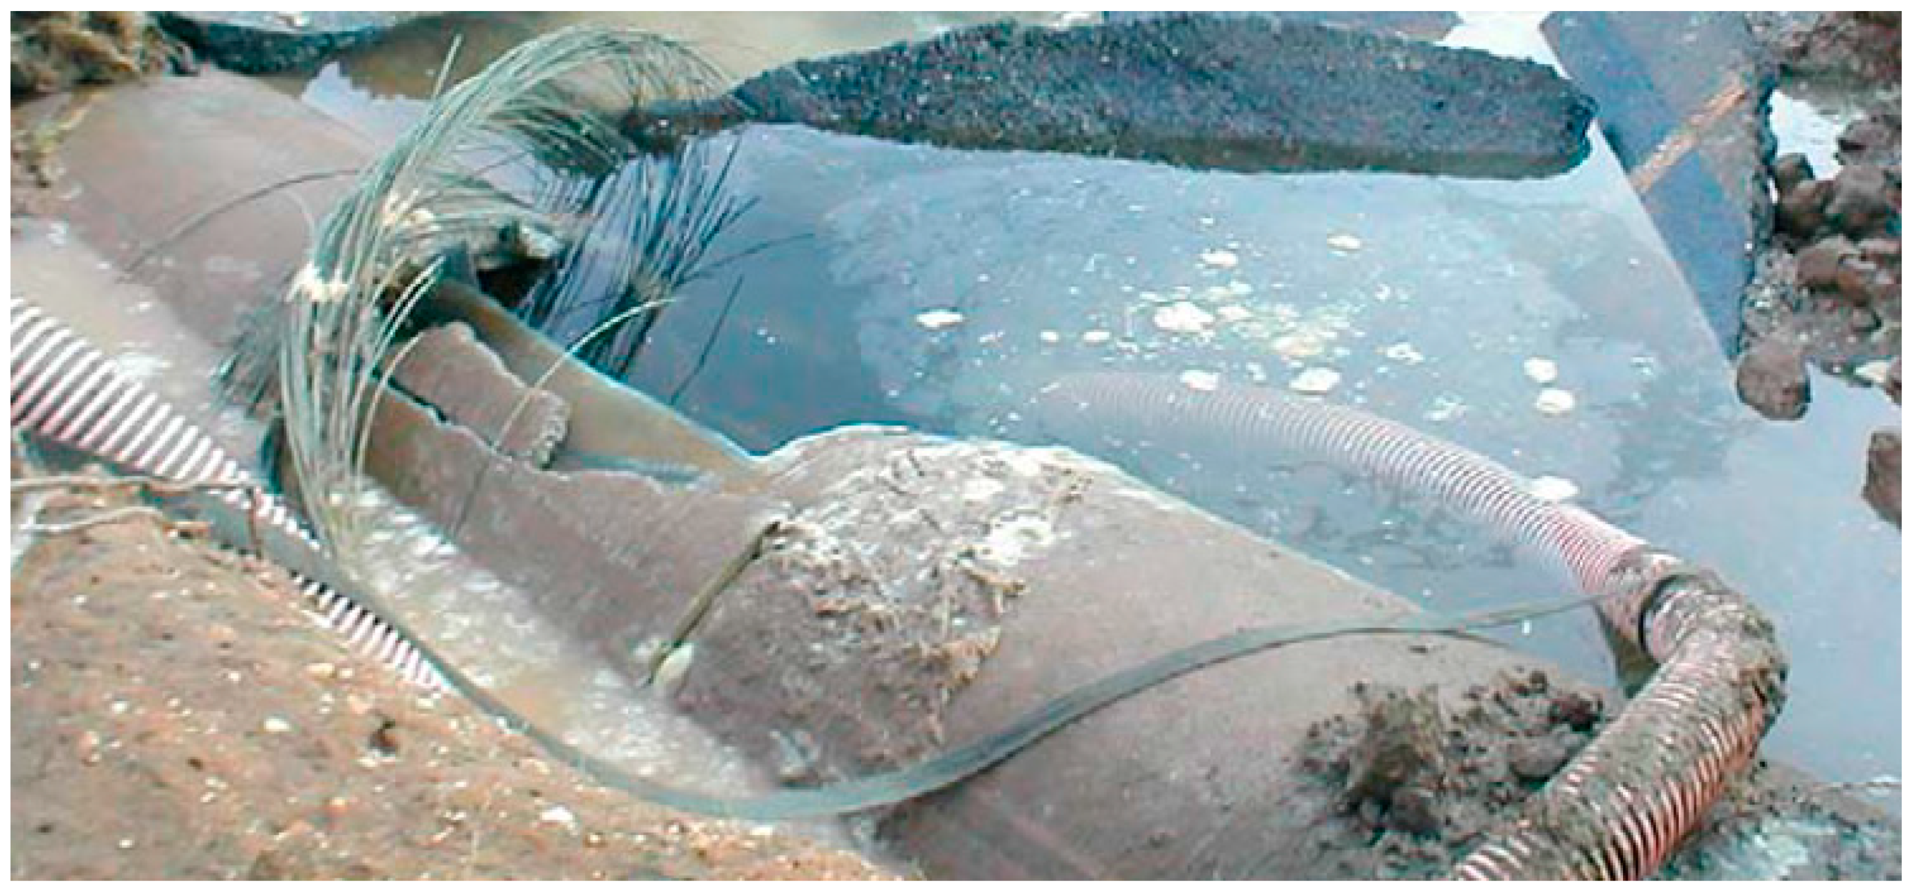
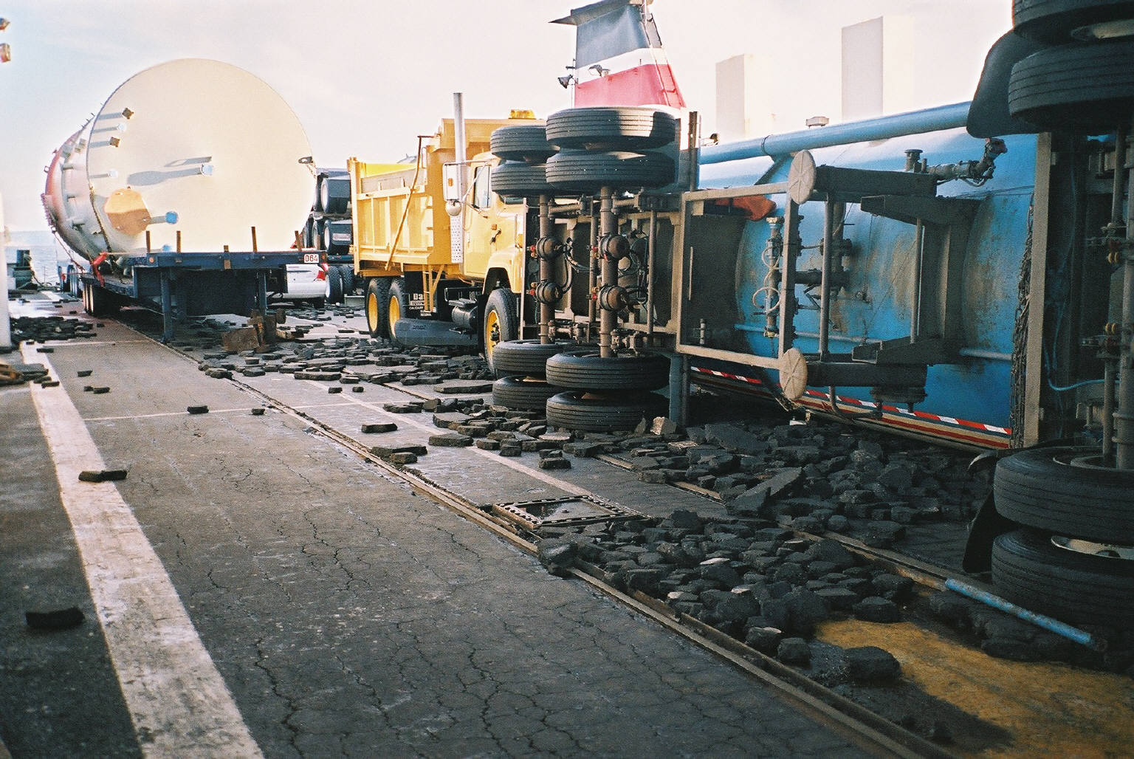
Evacuation & Notification Concepts
Who
What
When
Where
Why
How

Slide 14
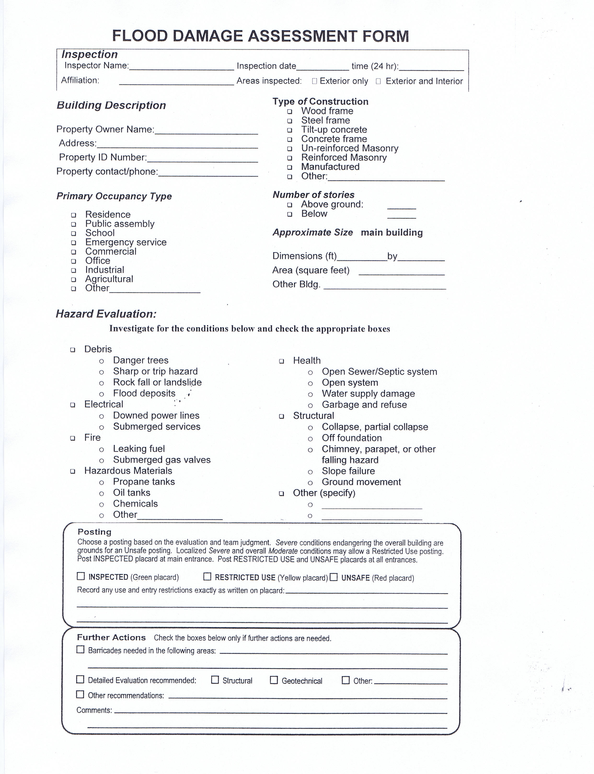
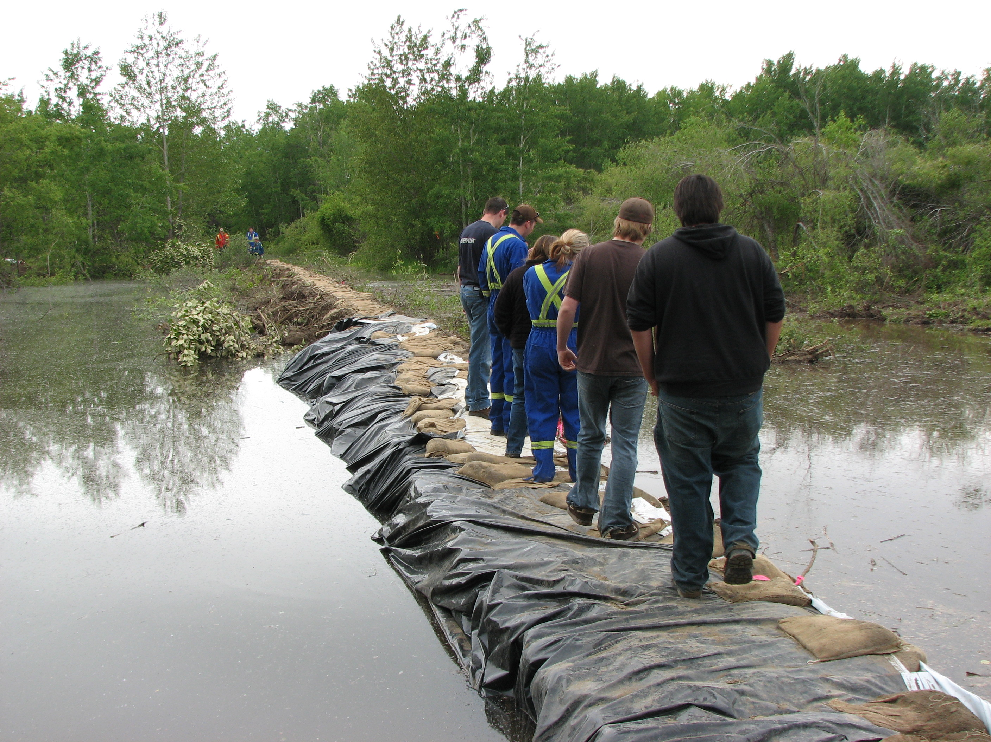
Post Flood
Damage assessment for re-entry

Slide 15
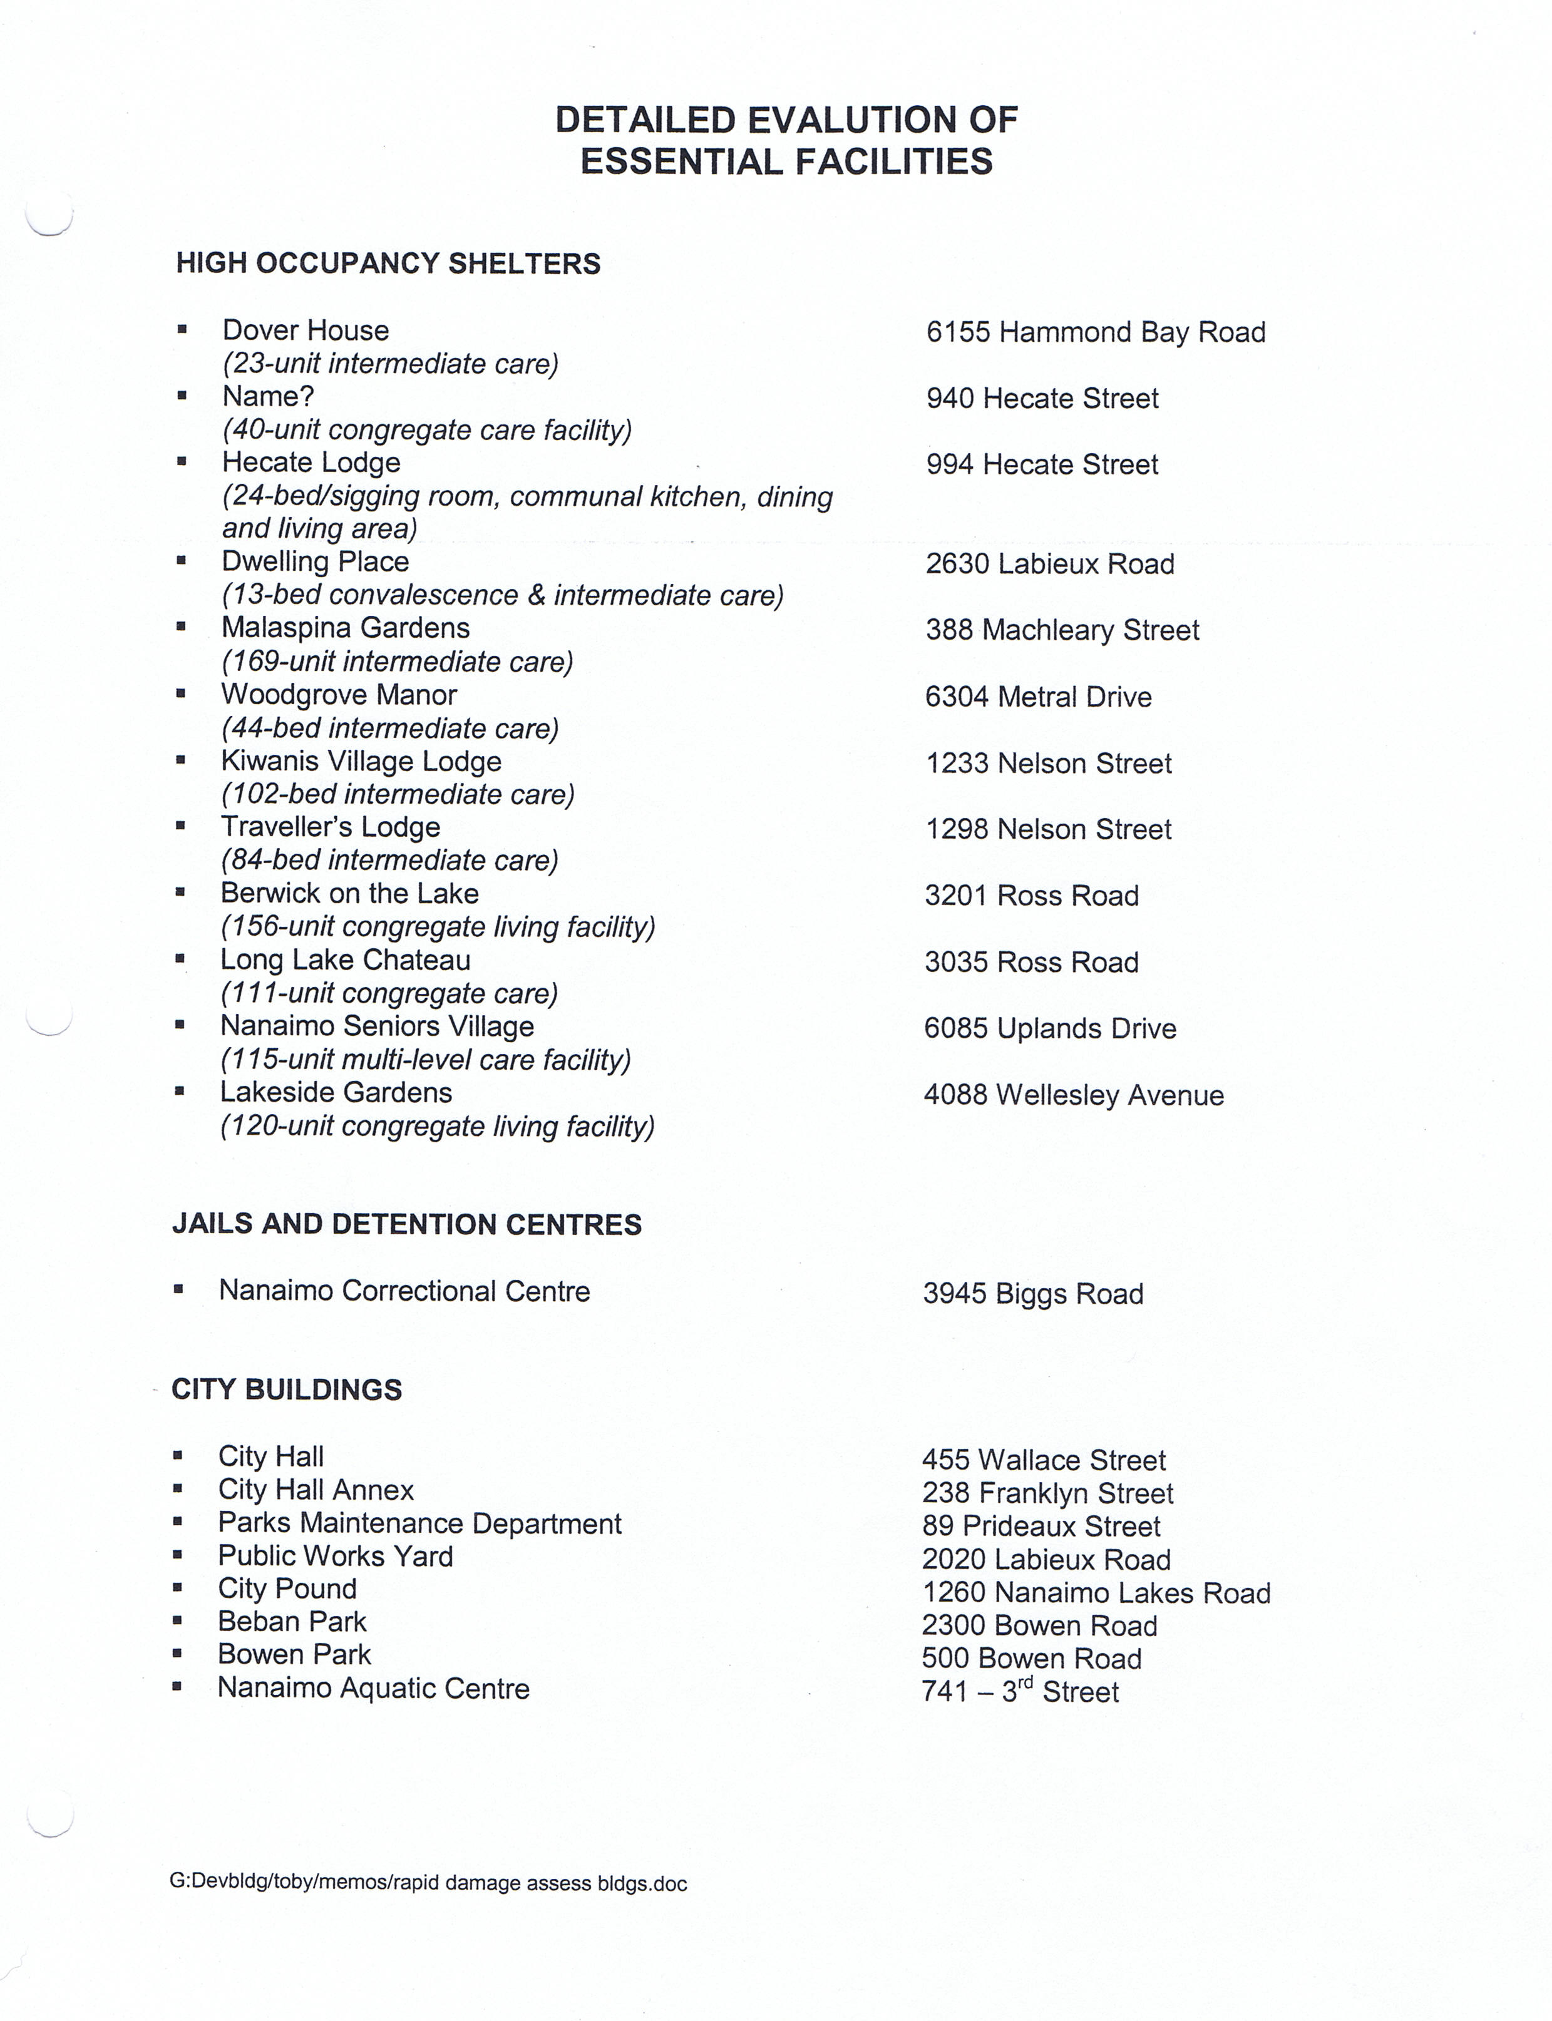
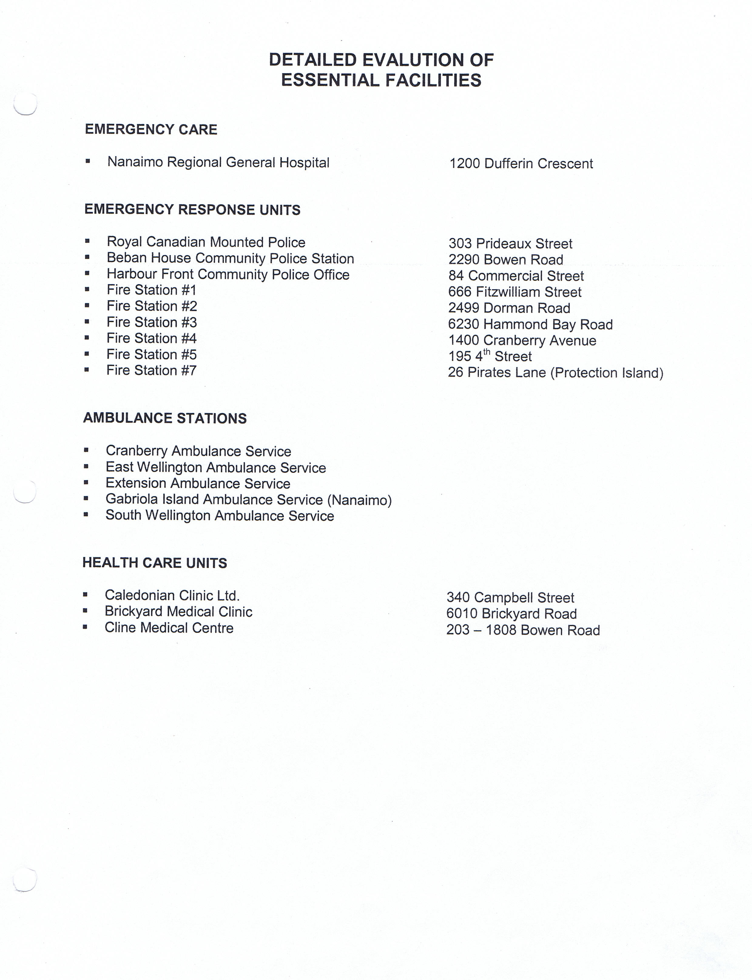
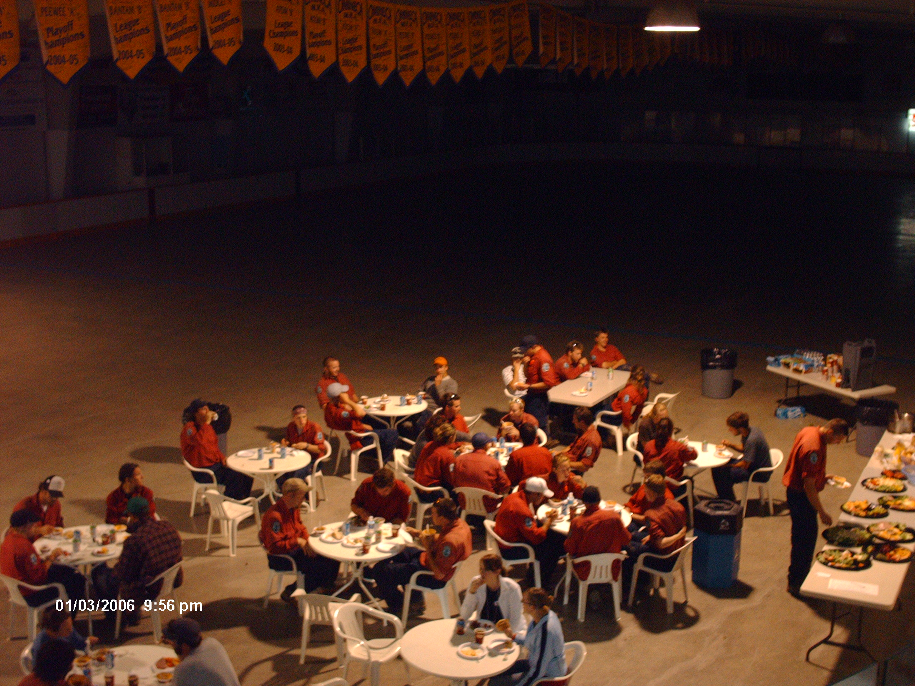
Identify Essential Facilities

Slide 16
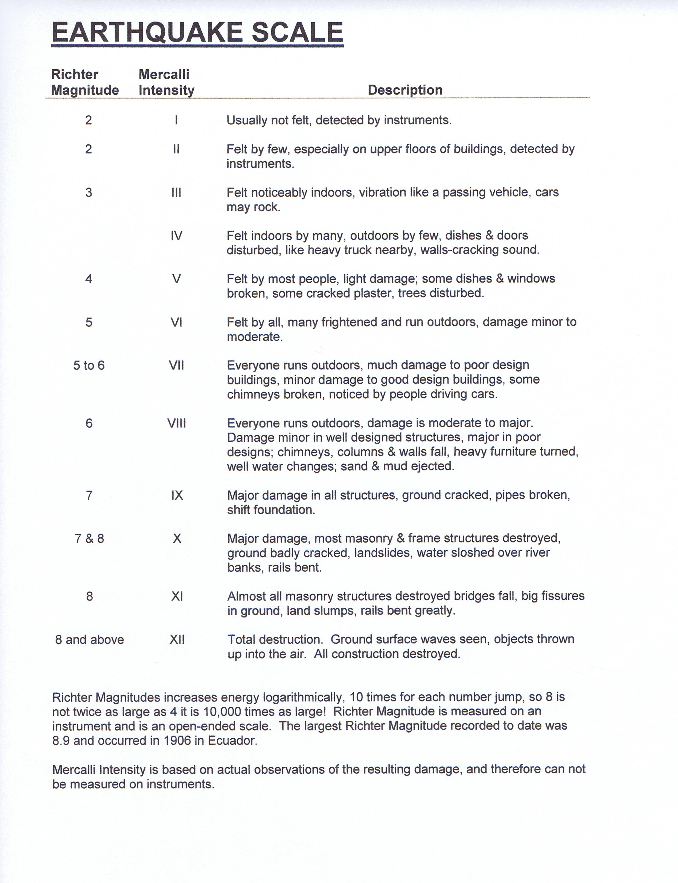
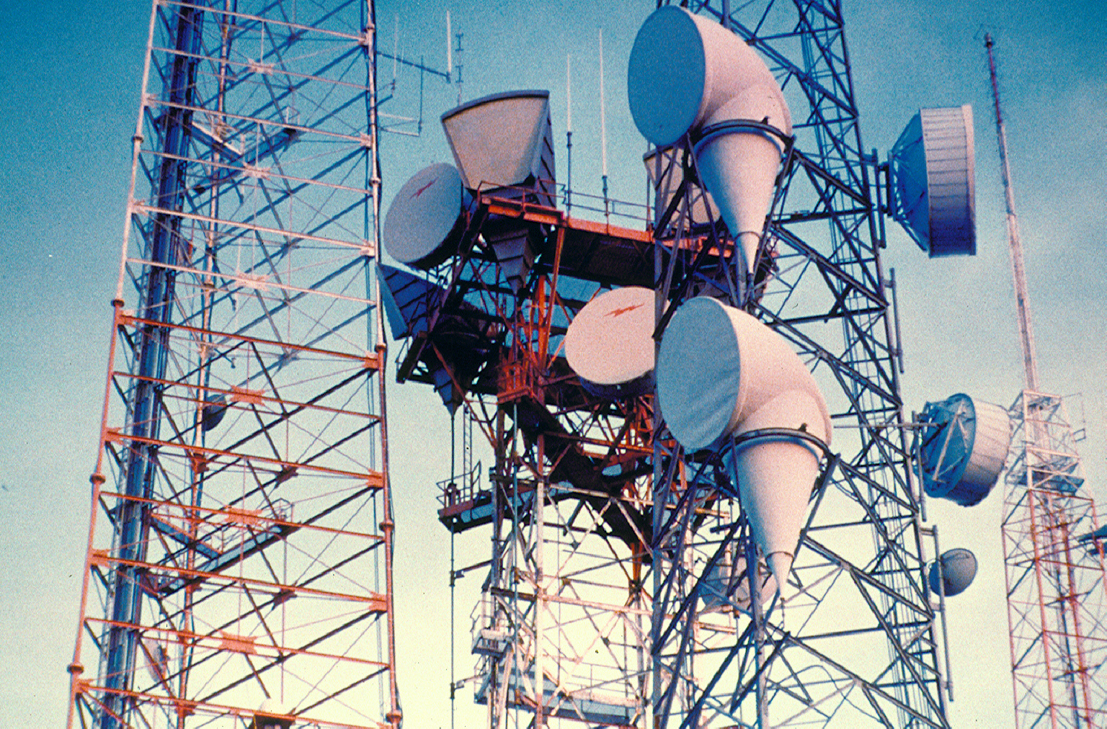
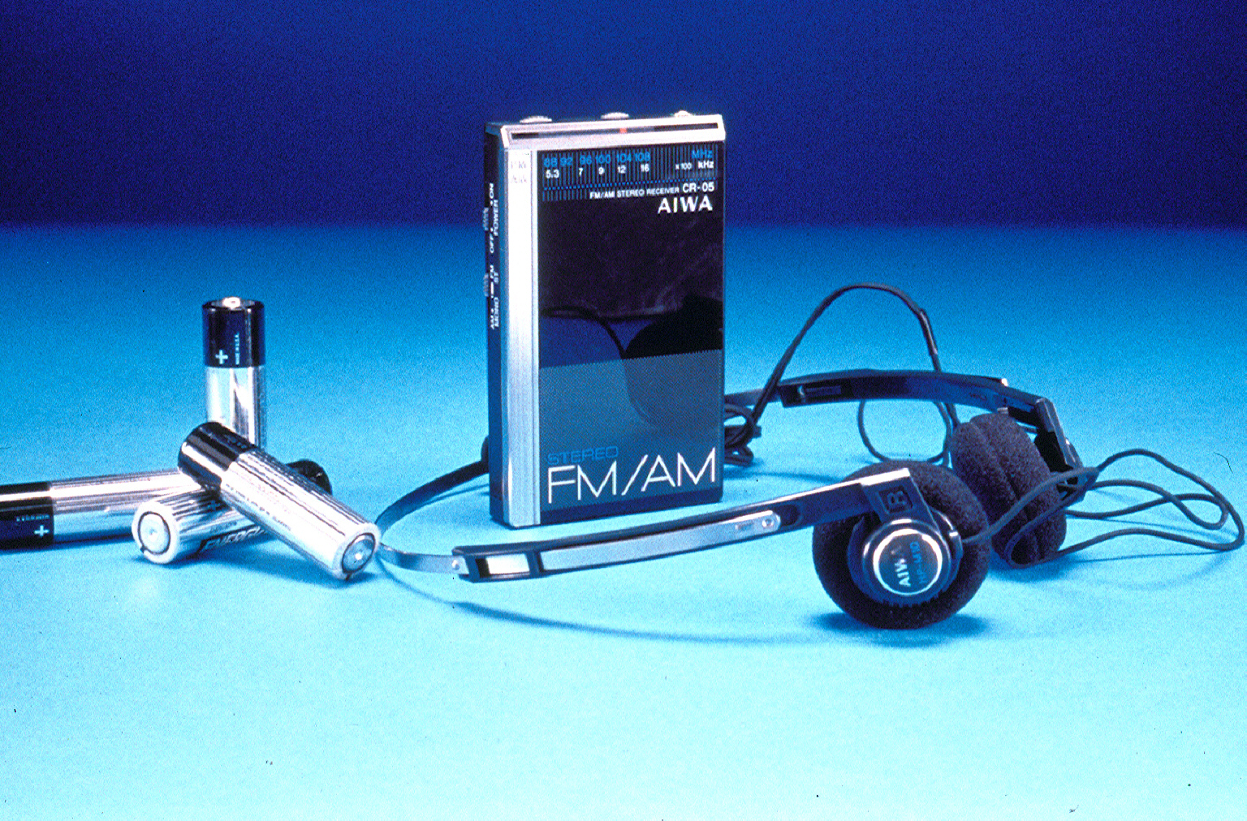
Amateur RADIO
USE SCALE TO REPORT VISUAL DAMAGE AT LOGIN

Slide 17
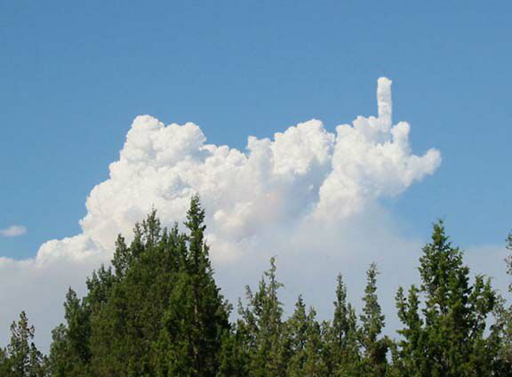
And You Know it’s Bad When…….

Slide 18
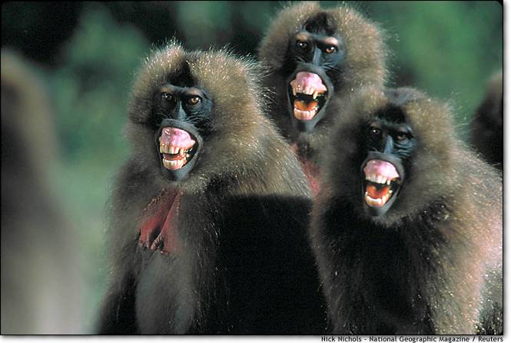
Questions???
There is only one stupid question…
The one that you don’t ask!

