Slide 1
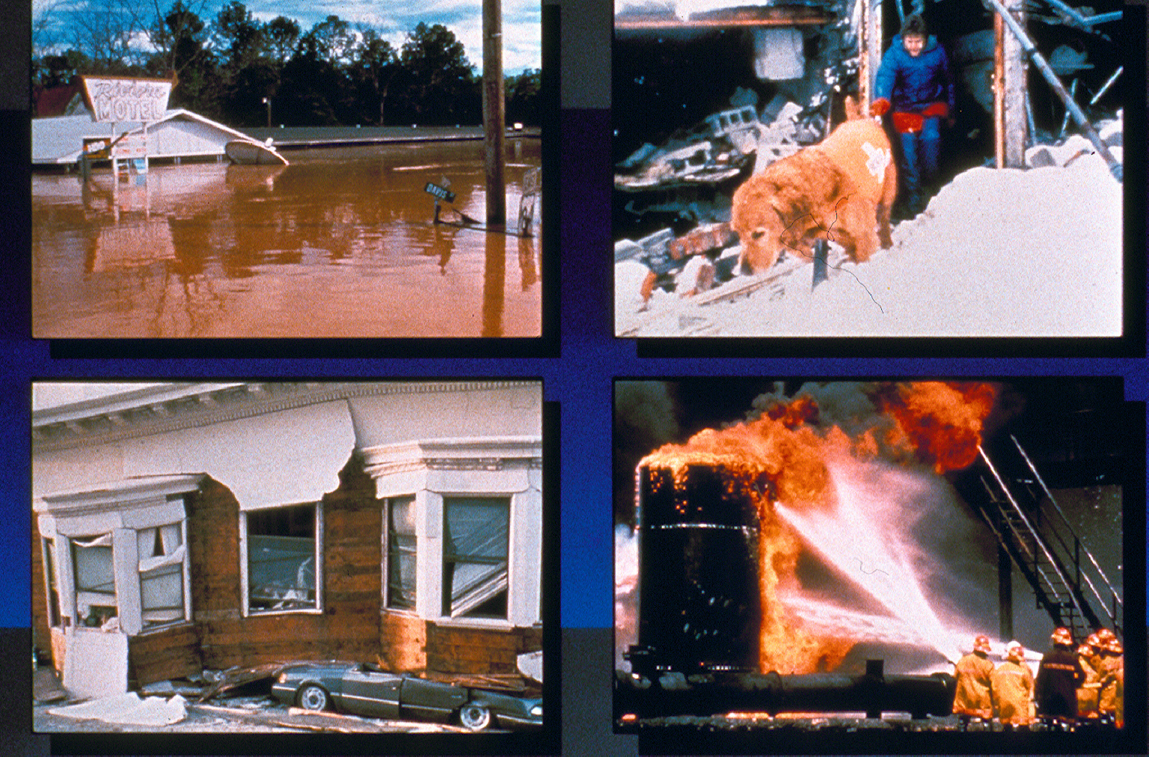
EMERGENCY MANAGEMENT 101
Emergency
Management, Coordination,
Response
and Recovery.
CLIMATE CHANGE AND GLOBAL WARMING
LEVEL 5 DROUGHT, NOVEMBER??
Notes:
Welcome
introcuction
program
presenter
content
time frame

Slide 2
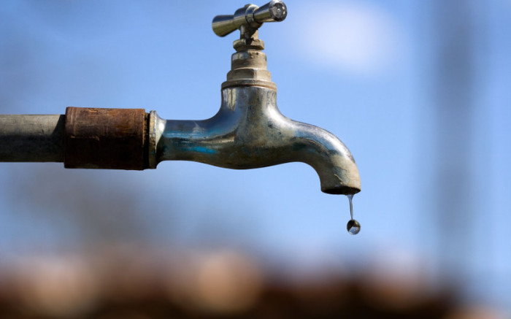
Common myths about disasters and preparedness.
It will never happen to me!
Its all insured so I’m OK.
I’m sure we would all cope.
You can’t plan for the unforeseen….
If I don’t have a disaster, I’ve wasted my money.
The government will take care of me right away… right?
WOULD YOU LIKE TO BUY AN ISLAND WATER SUPPLY?

Slide 3
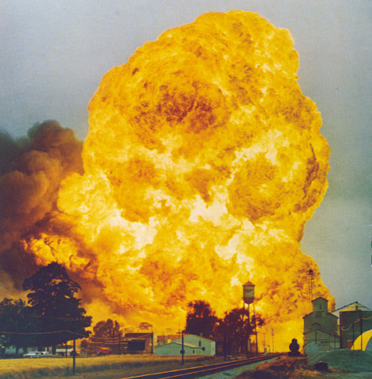
In the Business of Emergencies and Emergency Management
There is usually no next time, no 2nd chance
And there is no time out

Slide 4
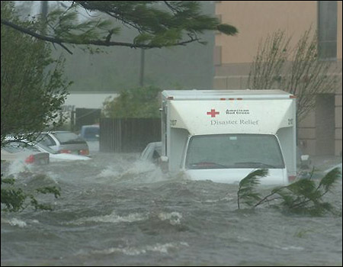
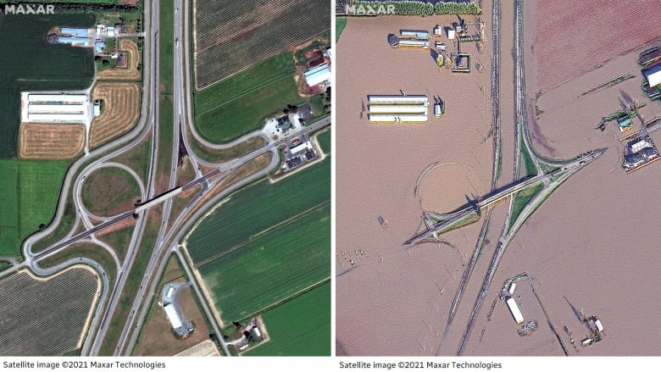
We know some events build slowly!
With FLOODING for example:
there will be a next time,
but still no 2nd chance,
or time out
NEW FLASH
HIGHER FREQUENCY GREATER INTENSITY

Slide 5
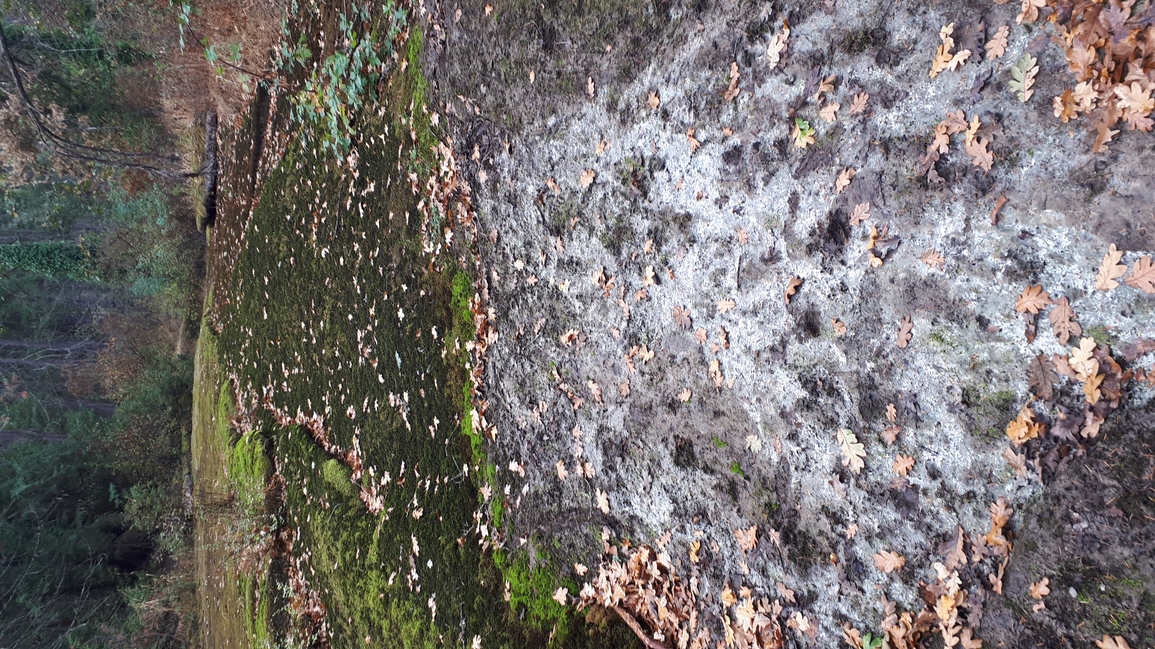
And some events just build!
With Pandemic Influenza for example:
there will be a next time,
but still no 2nd chance, or time out

Slide 6
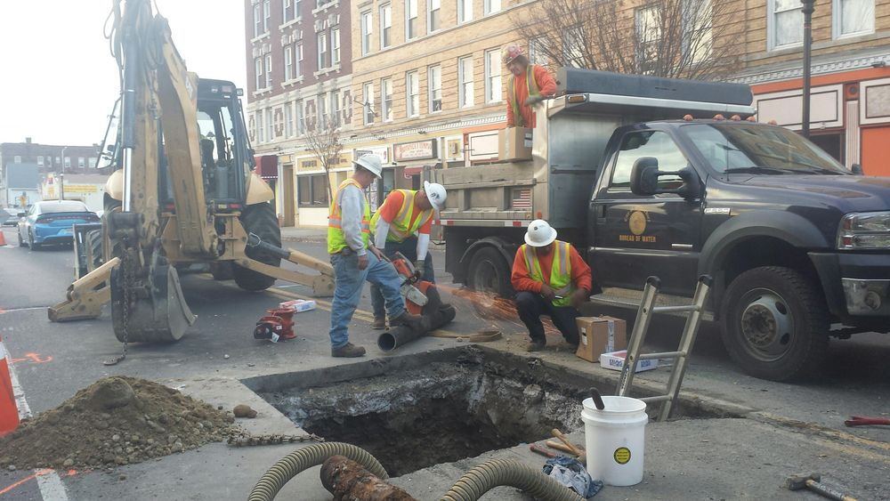
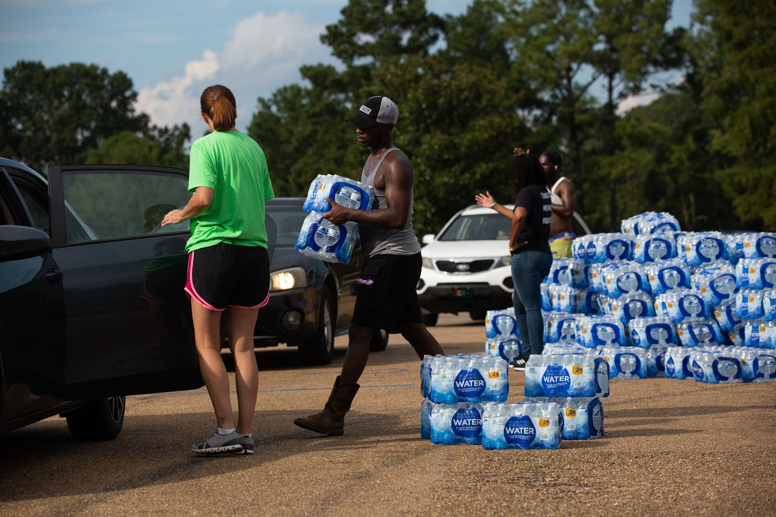
PLANNING OBJECTIVES

Slide 7
Emergency Program Guide Strategies for the six objectives.
Objective 1 — Assess Risks 1-1 Identify and Map Vulnerabilities 1-2 Research Risk Questions, Record Results 1-3 Identify and Map Risk Areas 1-4 Upgrade Risk Assessment Report | Objective 4 — Plan for Recovery 4-1 Establish Recovery Procedures 4-2 Identify Sources of Assistance 4-3 Adopt Community Redevelopment Plans
Objective 2 — Mitigate Risks 2-1 Identify Mitigation Options 2-2 Promote Fire Safe Community Program 2-3 Mitigate Dangerous Goods Risks 2-4 Facilitate Flood, Landslide Program 2-5 Revise Land Use Plan to Mitigate Risks | Objective 5 — Ensure Preparedness 5-1 Identify ECC Members and Alternates 5-2 Establish ECC Facilities and Equipment 5-3 Train ECC and Other Personnel 5-4 Conduct Exercises and Debrief 5-5 Advise Public on Preparedness
Objective 3 — Plan for Response 3-1 Verify Resource Contact Information 3-2 Update Agency Plans and Agreements 3-3 Plan for Evacuations 3-4 Facilitate ESS Program 3-5 Update Plan 3-6 Verify Response Capabilities | Objective 6 — Evaluate & Renew Program 6-1 Develop Record-Keeping Systems 6-2 Design Annual Report 6-3 Develop and Recognize Volunteers 6-4 Upgrade Program Guide

Slide 8
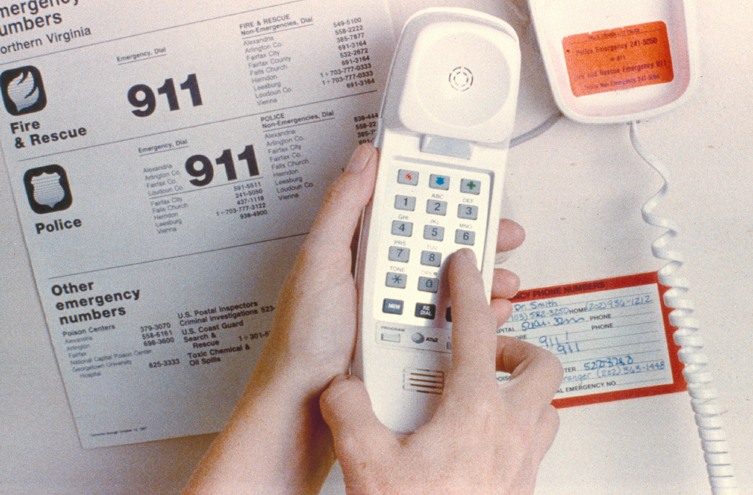
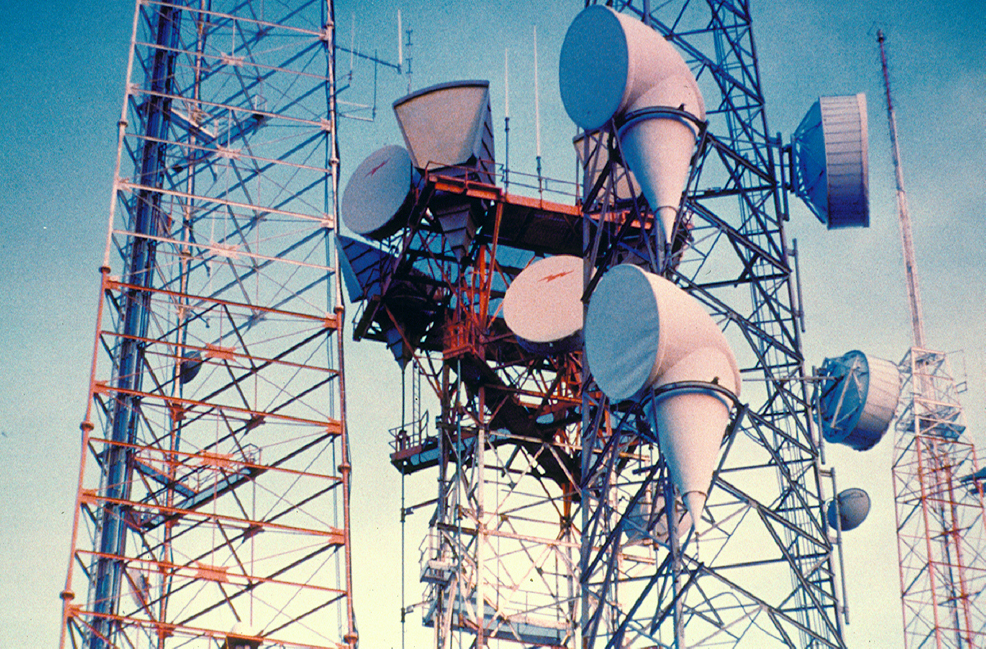
TASKS 1-1 Identify and Map Vulnerabilities
Rationale
Understanding hazards depends on a complete knowledge of
the infrastructure, buildings, and economic features that may
be affected. We must understand the potential impacts on
roadways, railroad, drainage systems, power supply lines,
water delivery systems, and other essential community
features. These community elements constitute
“vulnerabilities.” Identifying these elements and overlaying
with maps of threatened areas help the Emergency
Management Committee determine the most effective means
of mitigation, response, and recovery.
Project
Identify and describe current vulnerabilities at risk from major
emergency, highlighting and mapping key vulnerabilities,
including:
Current land uses
Neighbourhoods
Water systems
Energy supply system (Hydro and Gas)
Road / rail transportation system
Marine transportation system
Sewer disposal system
Tasks
Identify research questions and potential information sources.
Contact information sources to obtain map information, e.g., BC Hydro, Telus, Rail America, water suppliers, fire department and others with information on community vulnerabilities.
Work with neighbourhood groups to identify community features of particular value.
Create GIS data layers on existing City base maps for vulnerable features and provide in ECC.
Briefly describe each map layer, sources and limitations.
Responsible I/T, DSD and PW, working with
external agencies
Dates TBD
Budget TBD

Slide 9
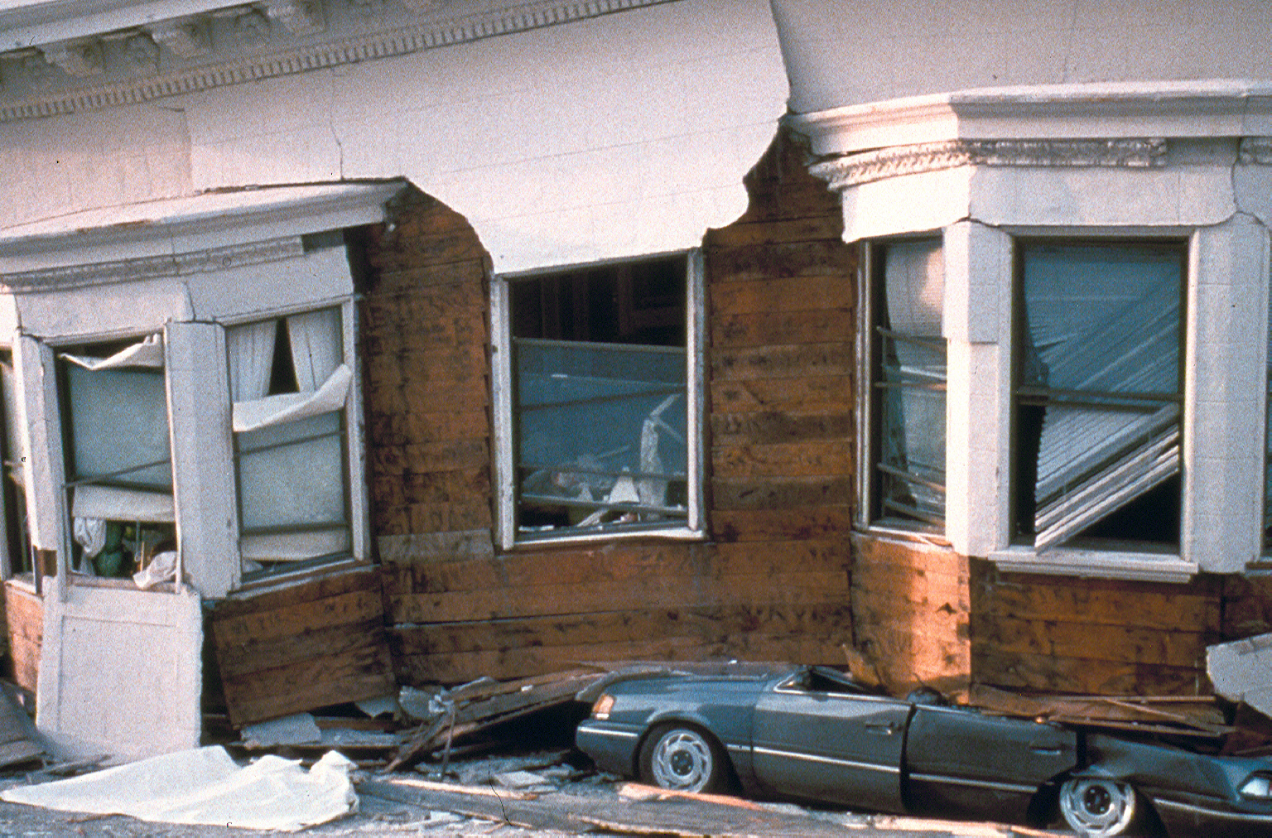
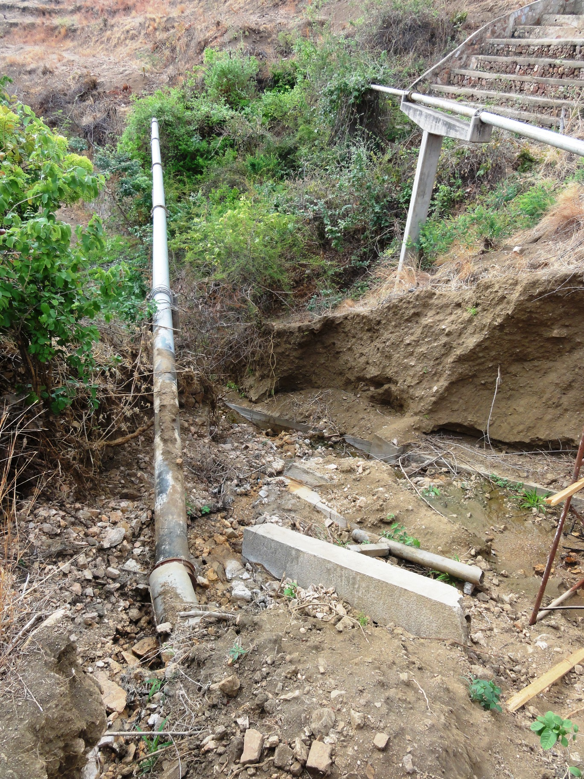
7 Principles of Risk Management
Global perspective
Forward-looking view
Open communication
Integrated management
Continuous process
Shared product vision
Teamwork

Slide 10
Categorized Disasters
Natural Industrial
Earthquake Urban Fire
Flood Hazardous
Forest Fire Materials
Landslide Explosion
Severe Weather Structural
Wind Storm Collapse
Transportation
Social/Political
Bomb Threat
Sabotage/Terrorism
Riot

Slide 11
Risk Assessment - WTSHTF
Aircraft Crash
Atmospheric Hazards
Dam Failure
Disease and Epidemics
Drought
Explosion
Fire
Urban
Industrial
Flooding
Hazardous Materials
Landslide or Debris Flows
Lost Persons
Marine incident
Motor Vehicle crashes
Power Outages
Rail Crashes
Seismic Event
Social disturbance
Structural Collapse
Telecommunications failure
Terrorism
Volcanic Ash Fallout
Wildfires
Getting back to Life or Business as usual!

Slide 12
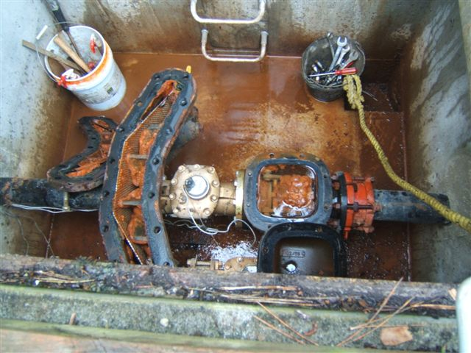
IDENTIFY RISKS

Slide 13
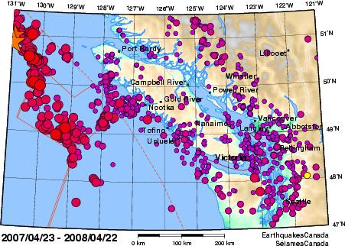
Simple subjective numeric risk calculations
Consequence
4 Catastrophic
3 Major
2 Serious
1 Minor
Probability
4 Certain
3 Probable
2 Possible
1 Unlikely
Earthquake 4 x 2 = 8 Hazmat 3 x 3 = 9

Slide 14
Incident Management by Objectives
Perform tactical direction
Select appropriate strategy
Establish incident objectives
Understand agency policy and direction
Notes:
Extremely important. Spend time explaining and how it relates to Response Goals. Give scenario to class and have them formulate objectives in their groups. Have them present and critique.
Objective is a statement of “What” you are going to do.
Strategy is a statement of “How” you are going to to do it
Tactics are the detailed action steps.
I’m going to secure the scene of this mva (Objective)
I’m going to place my pc across the road at the south end and have the next in unit place their rig across the road at the north end (strategy)
Placing the vehicle, ensuring the warning lights are on and maybe laying flares are the tactical actions.
These objectives, strategies and tactics are based on the response goals of protecting safety and health of responders, etc.

Slide 15
BCERMS and ICS
ICS is not BCERMS; BCERMS is not ICS

Slide 16
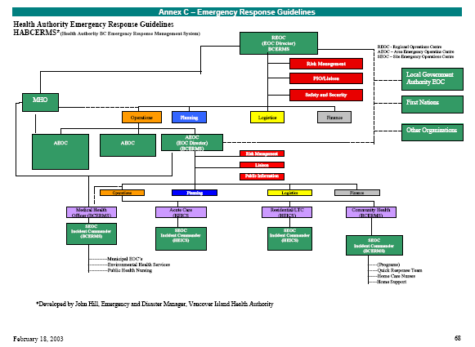
No need to re-invent the wheel!

Slide 17
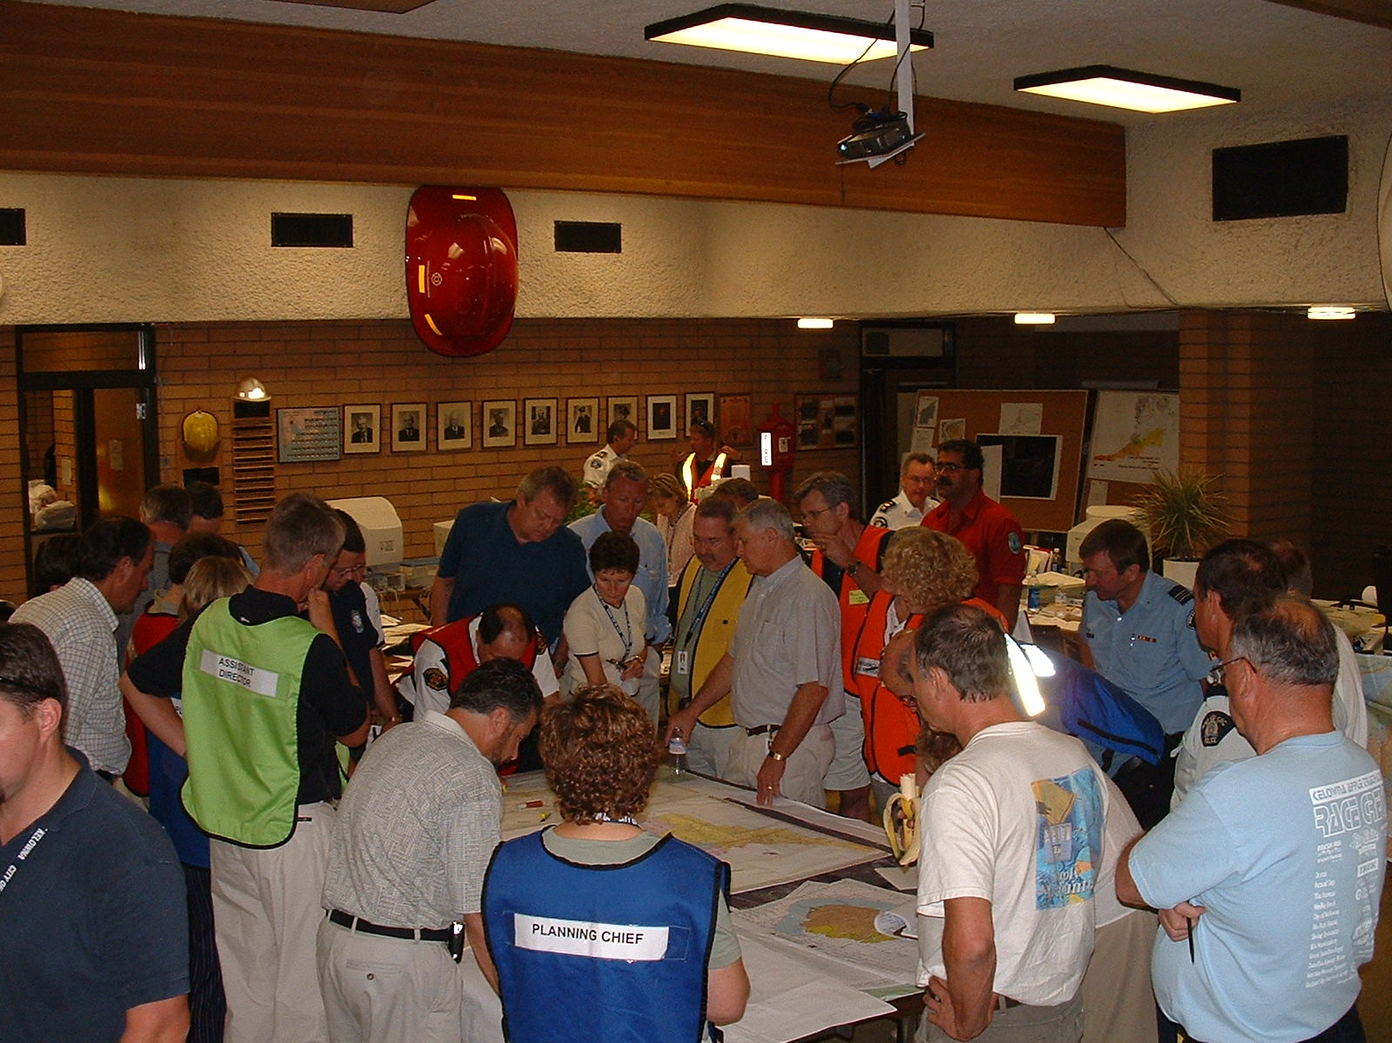
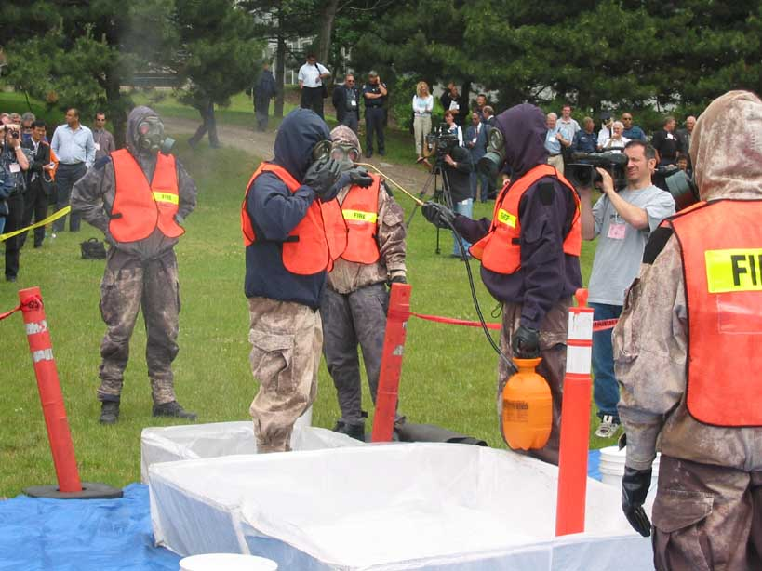
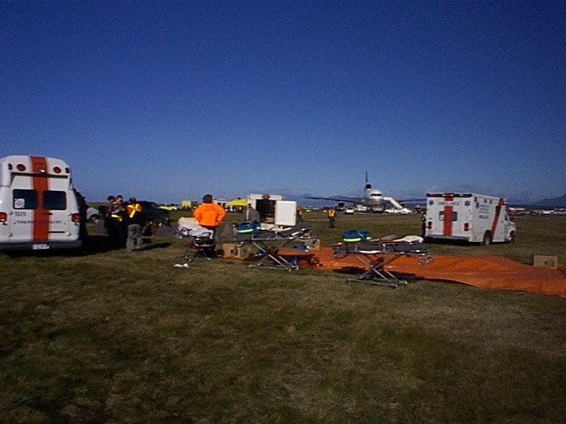
Emergency Operations Centre

Slide 18
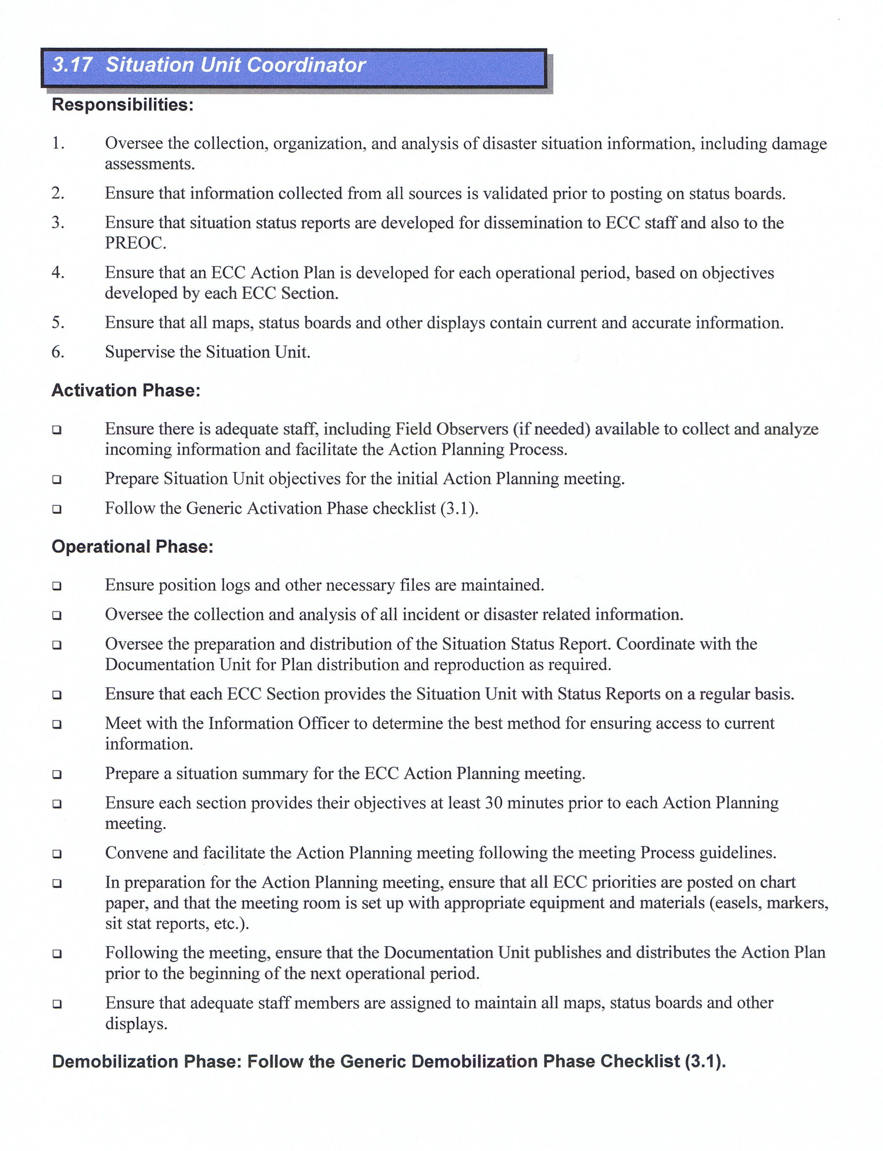
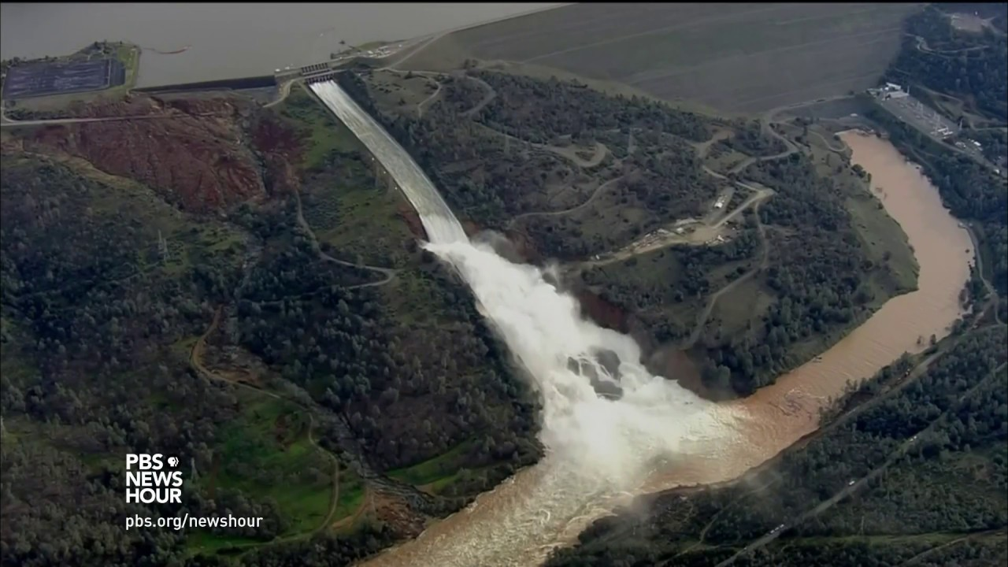
ICS POSITION PLANNING

Slide 19
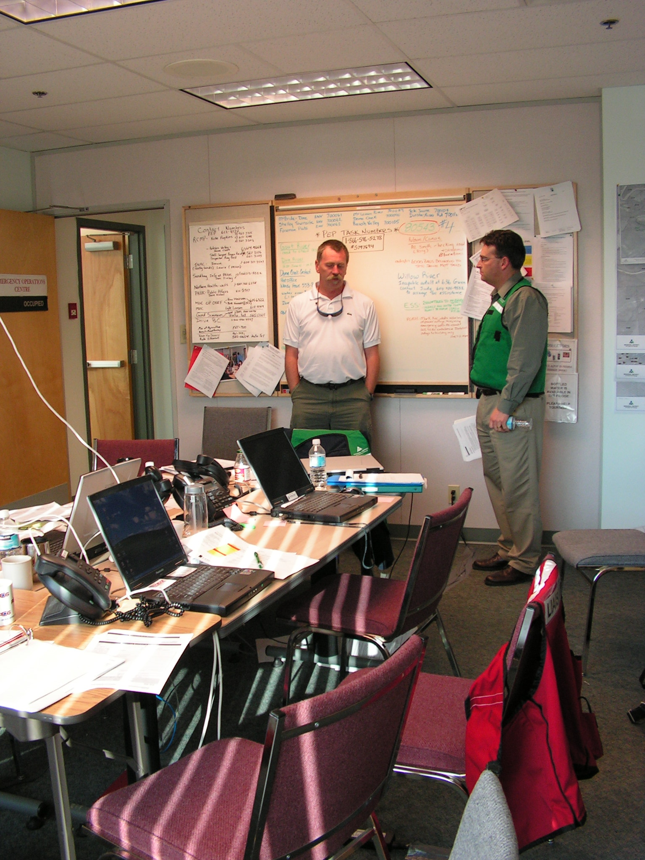
IDENTIFY, DEVELOP, MAP AND FUND FACILITIES

