Slide 1
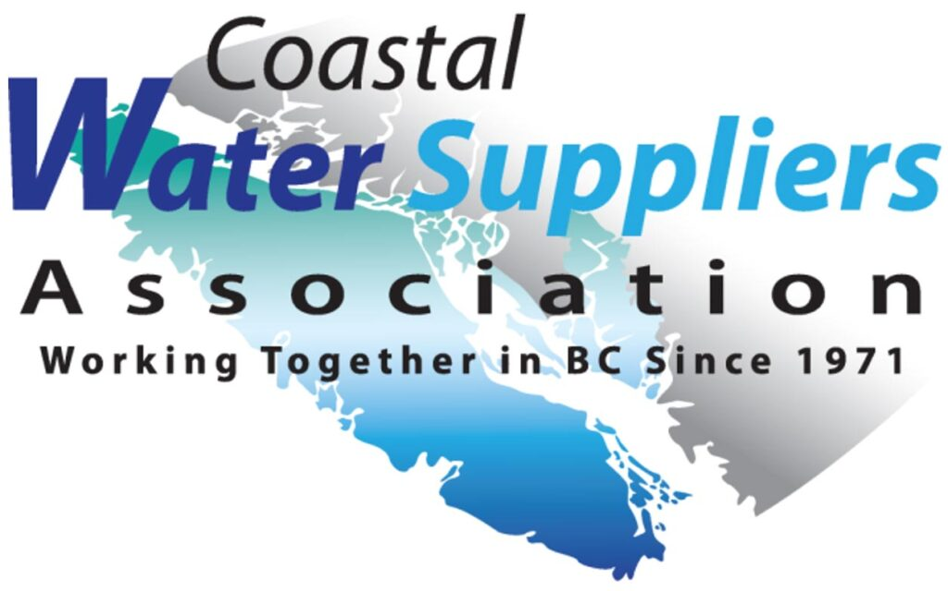
Practical Considerations for the Development of Groundwater Sources for Small & Medium Water Systems
A Joint Presentation, prepared for the:
2022 CWSA Annual Conference, AGM, & Trade Show
Coast Bastion Hotel, Nanaimo, Thursday November 17th, 2022
Jim Fyfe – Fyfe Well & Water Services (Qualicum Beach, BC)
Ineke Kalwij – Oceanside Hydrogeology Ltd. (Parksville, BC)
affiliated with Kalwij Water Dynamics Inc. (Vancouver, BC)

Slide 2
PRACTICAL CONSIDERATIONS FOR DEVELOPMENT of Groundwater SOURCES FOR SMALL & MEDIUM WATER SYSTEMS
Part 1 – The Context – Groundwater as Supply Source
Part 2 – Key Considerations for Successful Groundwater Source Development

Slide 3
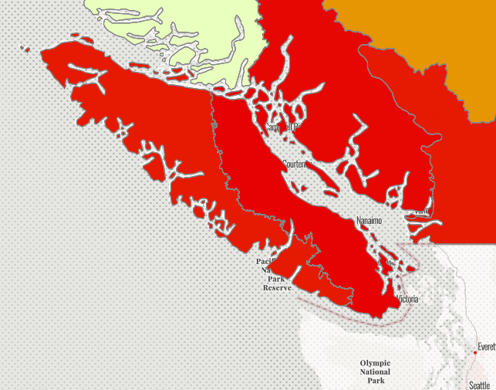
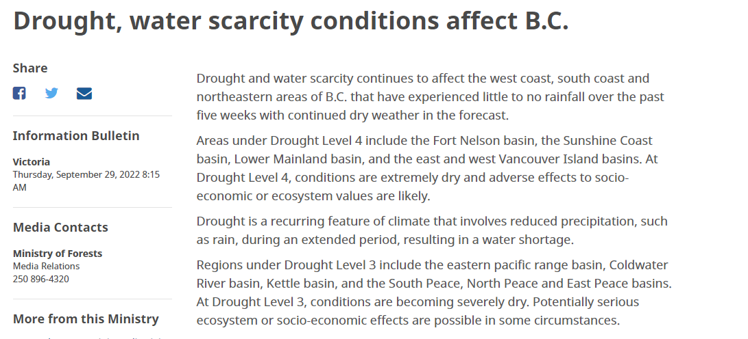
Droughts – Impacting People & Ecosystems
Drought levels
Fort Nelson Basin
Sunshine Coast Basin
East & West Vancouver Island Basins
https://news.gov.bc.ca/releases/2022FOR0069-001459
https://governmentofbc.maps.arcgis.com/apps/MapSeries/index.html?appid=838d533d8062411c820eef50b08f7ebc
2022 Drought – No significant rainfall starting July - until in October

Slide 4
Droughts – Impacting People & Ecosystems
Surface sources are running dry
Environmental consequences (salmon habitat)
Societal & economic consequences (water supply)
Declining Groundwater Levels
Impacting streams (base flow)
Societal & economic consequences (water supply)

Slide 5
Many Communities Observe an Increase in Population
…expanding surface water source is often not an option – groundwater is the next option!

Slide 6
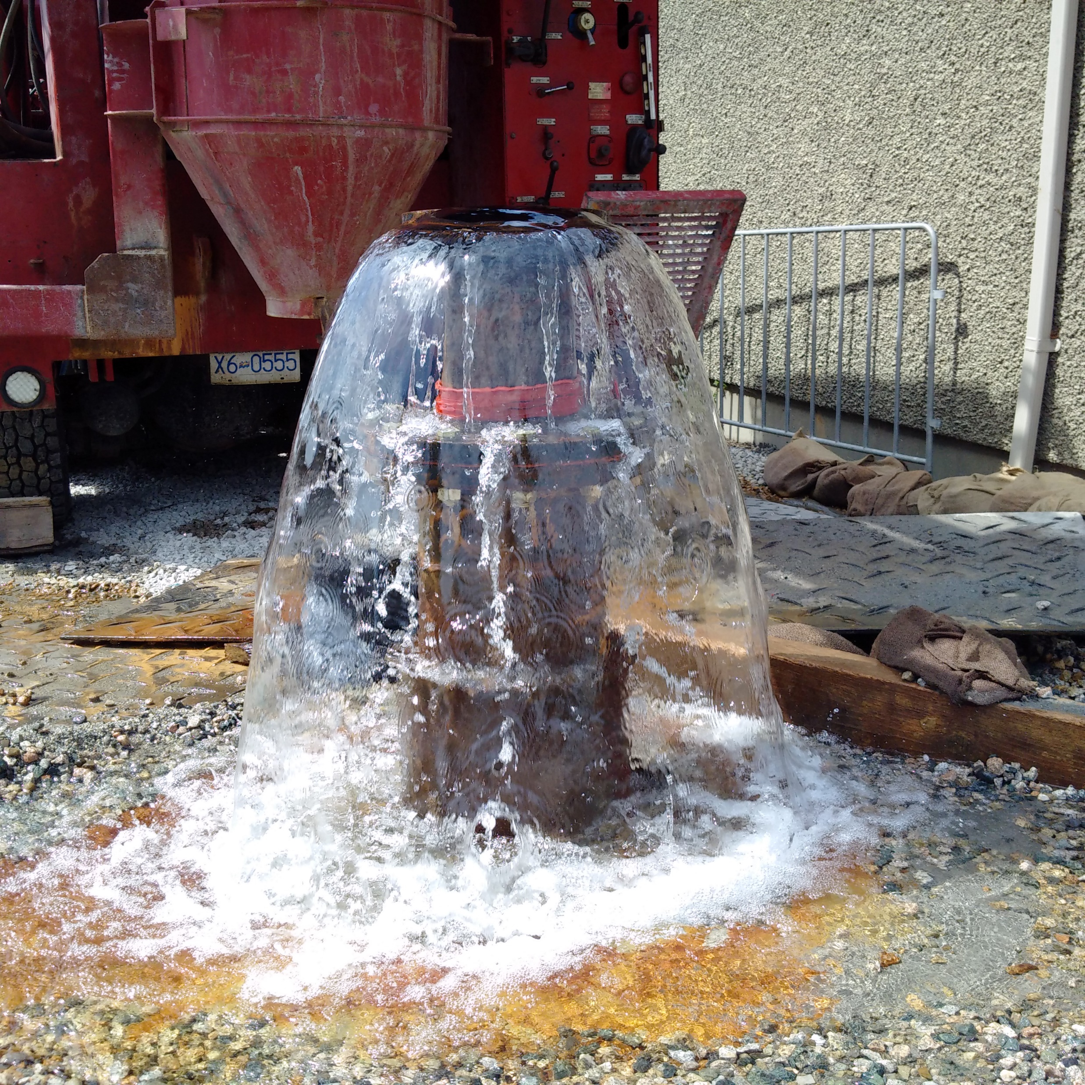
Groundwater as a Source of Water Supply…
Groundwater storage is much less affected by reduced inflow during a prolonged drought.
Improves drought & climate change resiliency … water storage in aquifers.
Generally good water quality in terms of microbiology (total coliforms, E. coli) and turbidity.

Slide 7
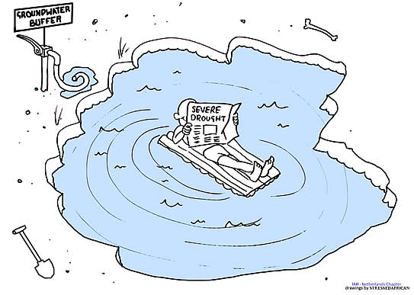
Groundwater
“Groundwater offers opportunities for water utilities to develop and operate water-supply sources that are more resilient to climate-change and more reliable in extended drought than surface water sources”
International Association of Hydrogeologists -
BUT must be properly managed!
ALSO, global warming could lead to reduced groundwater recharge impacting the reserves of [low-storage] shallow aquifers
https://www.hydrology.nl/iahpublications/201-groundwater-cartoons.html
IMPORTANT, Groundwater / aquifers intrinsically complex (invisible, uncertainty, heterogeneity) - is a specialized field.
https://iah.org/wp-content/uploads/2021/08/IAH-Water-Utilities_Groundwater-July2021.pdf

Slide 8
Groundwater Source Development – from start to finish
Preparatory Work (Well siting, Archeological Investigation)
Hydrogeological Field Investigation
Well design
Production well drilling & construction
Permits
Technical Assessments (Hydrogeological, Environmental)
Civil / mechanical / electrical / SCADA
Water authorization, construction permit
Tie-in to the water system, mechanical completion
Source Approval (Health)
Well commissioning
Pumping Tests

Slide 9
Successful Groundwater Source Development to Small & Medium Water Systems
Three Key Considerations
1. Completing an Initial Planning / Screening
2. Adopt a team / holistic approach … from start to finish
3. Identify Factors that Could Impede Groundwater Development Process

Slide 10
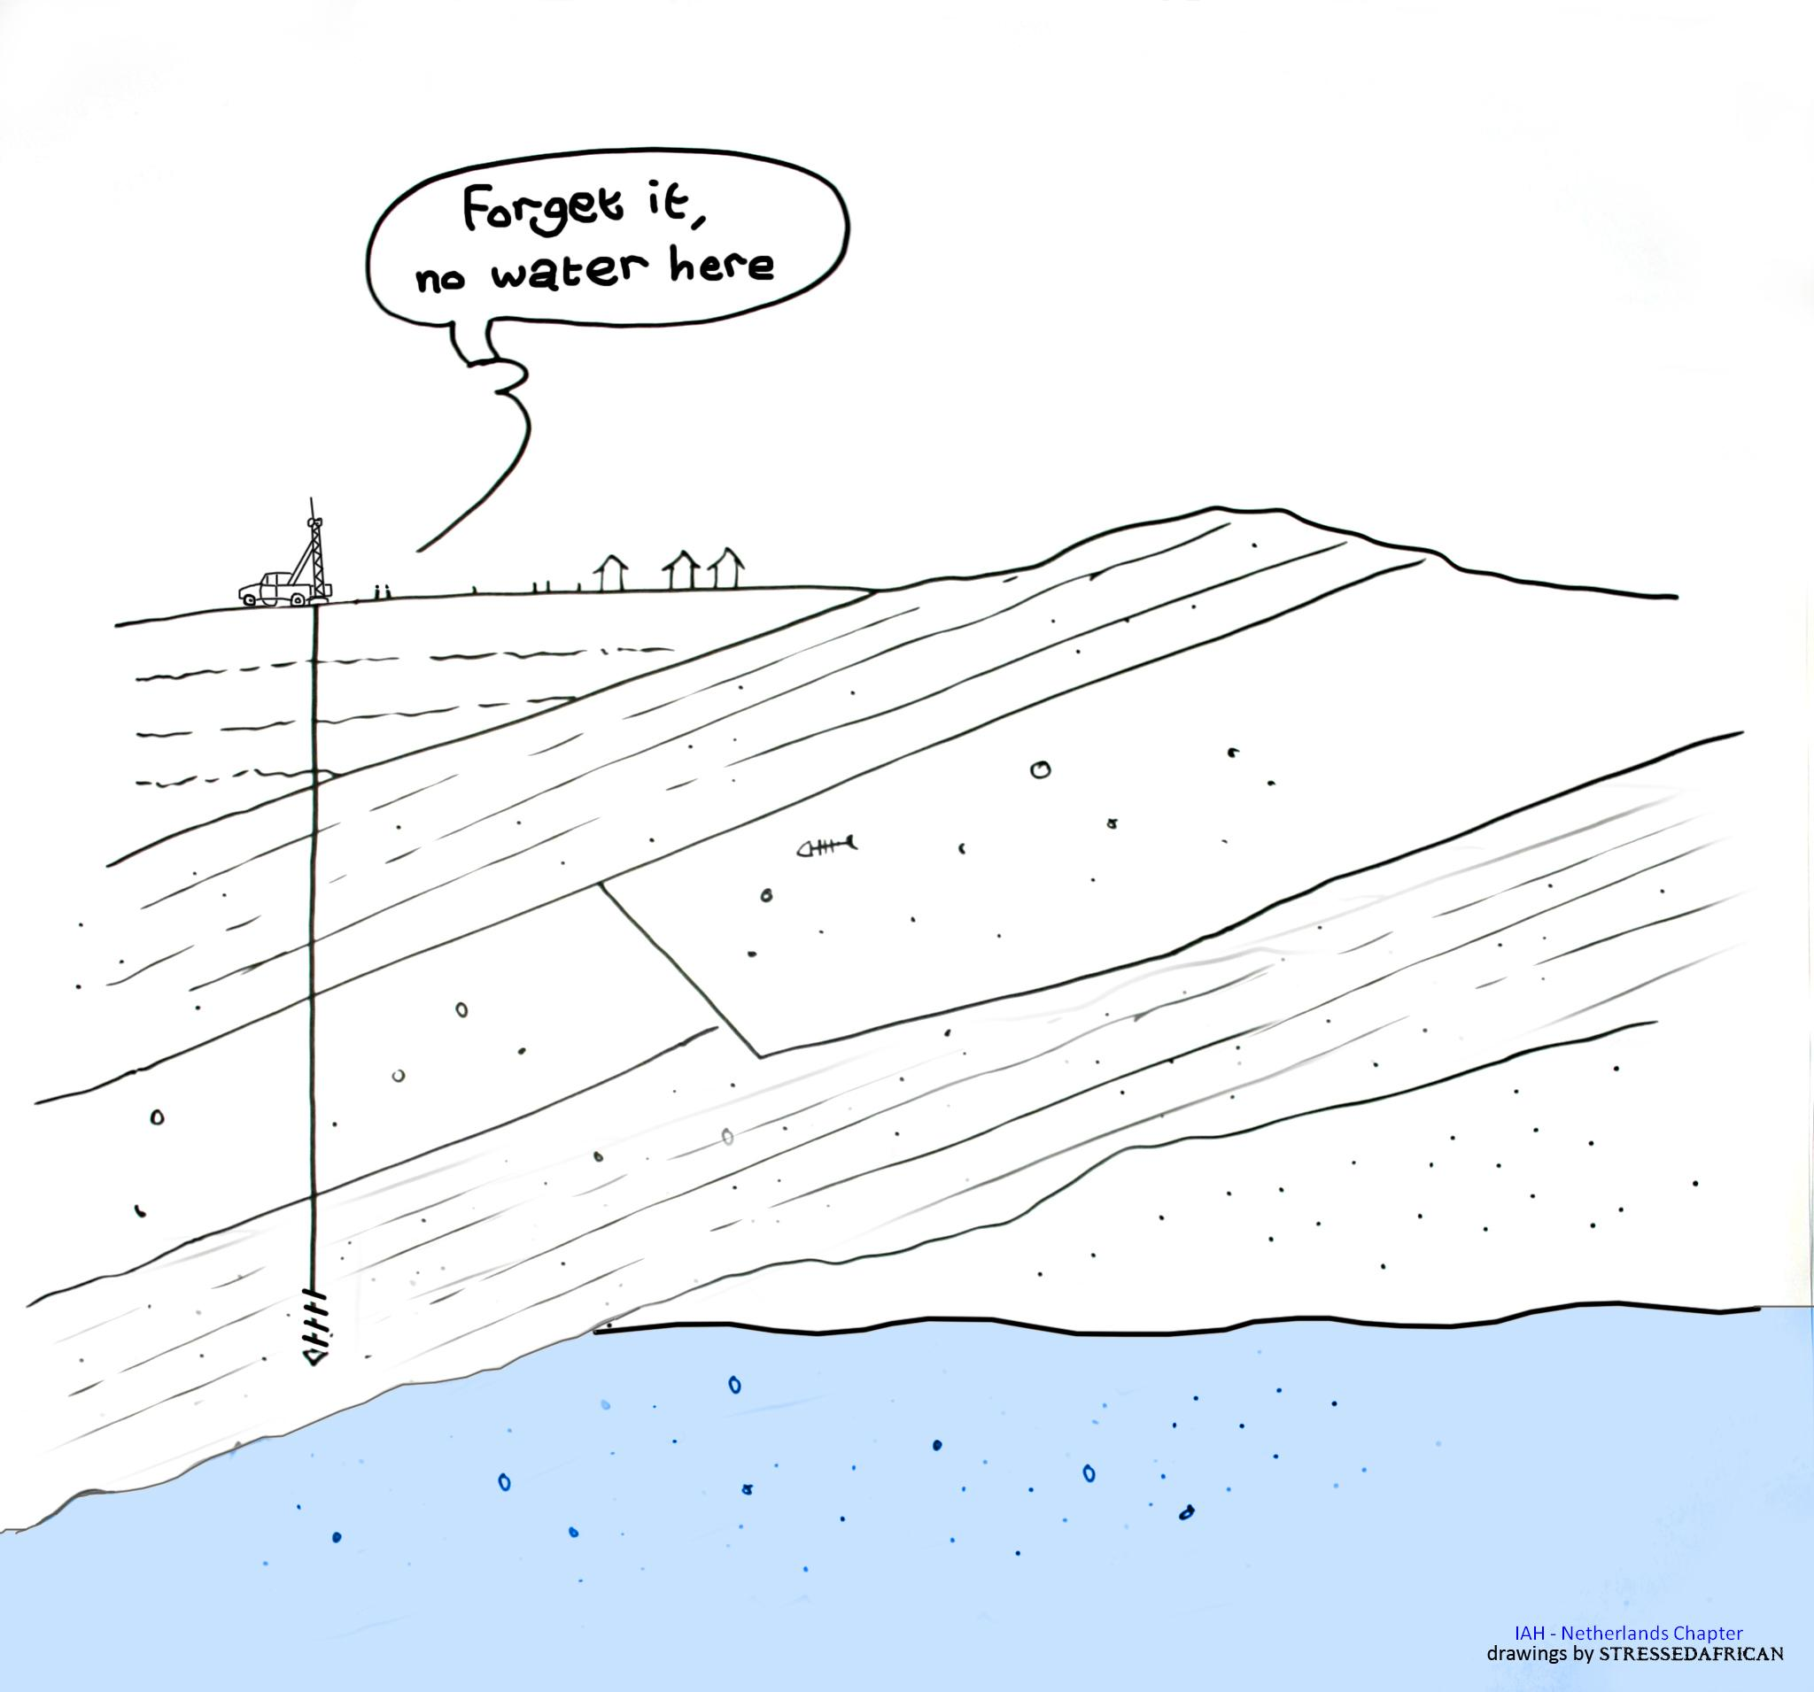
1 – Groundwater Source Development – Initial Planning / Screening
https://www.hydrology.nl/iahpublications/201-groundwater-cartoons.html

Slide 11
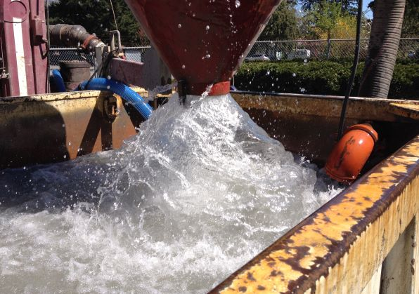
1 – Groundwater Source Development – Initial Planning / Screening
Requires addressing the following questions:
Is it feasible to augment existing system with groundwater?
In long-term water demand known?
Does the water system have infrastructure to enable integration of new groundwater source(s)?
Does new groundwater source (GW) integrate well with existing source?
Is there a backup supply?
Is the water system / community under urgent pressure to increase water supply?

Slide 12
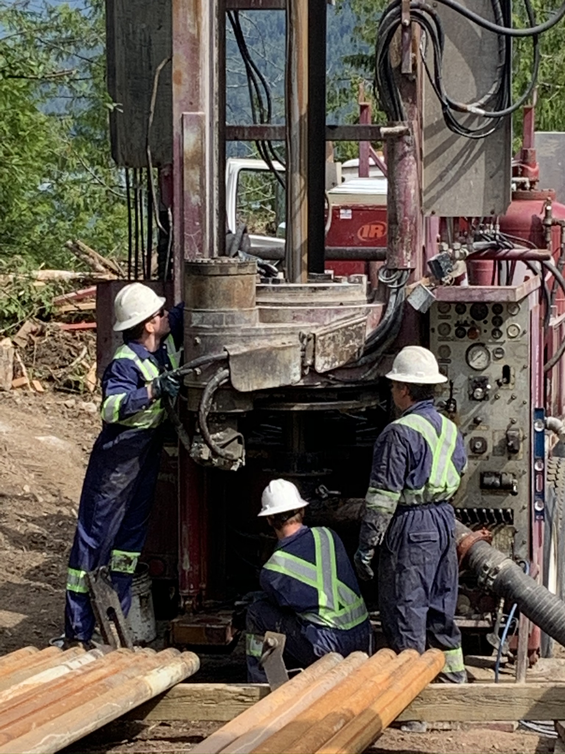
1 – Groundwater Source Development – Initial Planning / Screening
Requires addressing the following questions:
Does Board / Strata have mandate from users to develop a new GW source?
Does Board / Strata understand key steps in the GW source development process?
Planning
Budget
Exploratory drilling
Design well construction program
Technical reporting requirements (hydrogeology, other [ environmental flow need) – in support of GW license
All other work / steps necessary to tie-in / commission the wells

Slide 13
2 – Groundwater Source Development – requires a team approach … from start to finish

Slide 14
A Well Project is a Collaborative (Team) Effort!
Well Owners / Board of Directors for Strata
Other (e.g.: Environmental Consultant)
Water System Operators
Hydrogeologist / Project Manager
Civil / Mechanical / Electrical / Communications (SCADA) Consultants
Contractors (structural, tie-in, electrical, etc.)
Drilling Contractor / Pump Contractor – Prime Contractor
Regulatory Agencies (Local Government, Municipality, Health Authority, Prov. Ministries, MOTI, Regional Districts) & Archaeological requirements (impact assessment – if needed).

Slide 15
3 – Identify Factors that Could Impede Groundwater Development Process

Slide 16
3 – Identify Factors that Could Impede Groundwater Development Process
Budget – needs sufficient contingencies to cover the unexpected.
Land ownership – owning land, needing to purchase land, or obtaining an easement.
Need for archaeological assessment (Heritage Conservation Act), related permit approvals (First Nations) – may delay the project (start of drilling), depending on the outcome may require further steps.
The planned number of wells may not be sufficient to meet water demand – more wells are needed.
Water quality of such poor quality that is would not be considered a viable source (i.e.: brackish water).

Slide 17
3 – Identify Factors that Could Impede Groundwater Development Process
Groundwater Licensing – can be complex / overwhelming, depending on many factors (requested volume, stream aquifer interaction); it takes typically a long time before an officer is allocated to the file.
Technical Assessment requirements – ultimate requirements by the Statutory Decision Maker.
Environmental Flow Need Requirements – added cost – time consuming.
Location – sensitive streams, fully recorded streams, hydraulic connection stream-aquifer, critical aquifers.
Sensitive streams – Schedule B in the Water Sustainability Regulation – on Vancouver Island: French Creek and Englishman River.

Slide 18
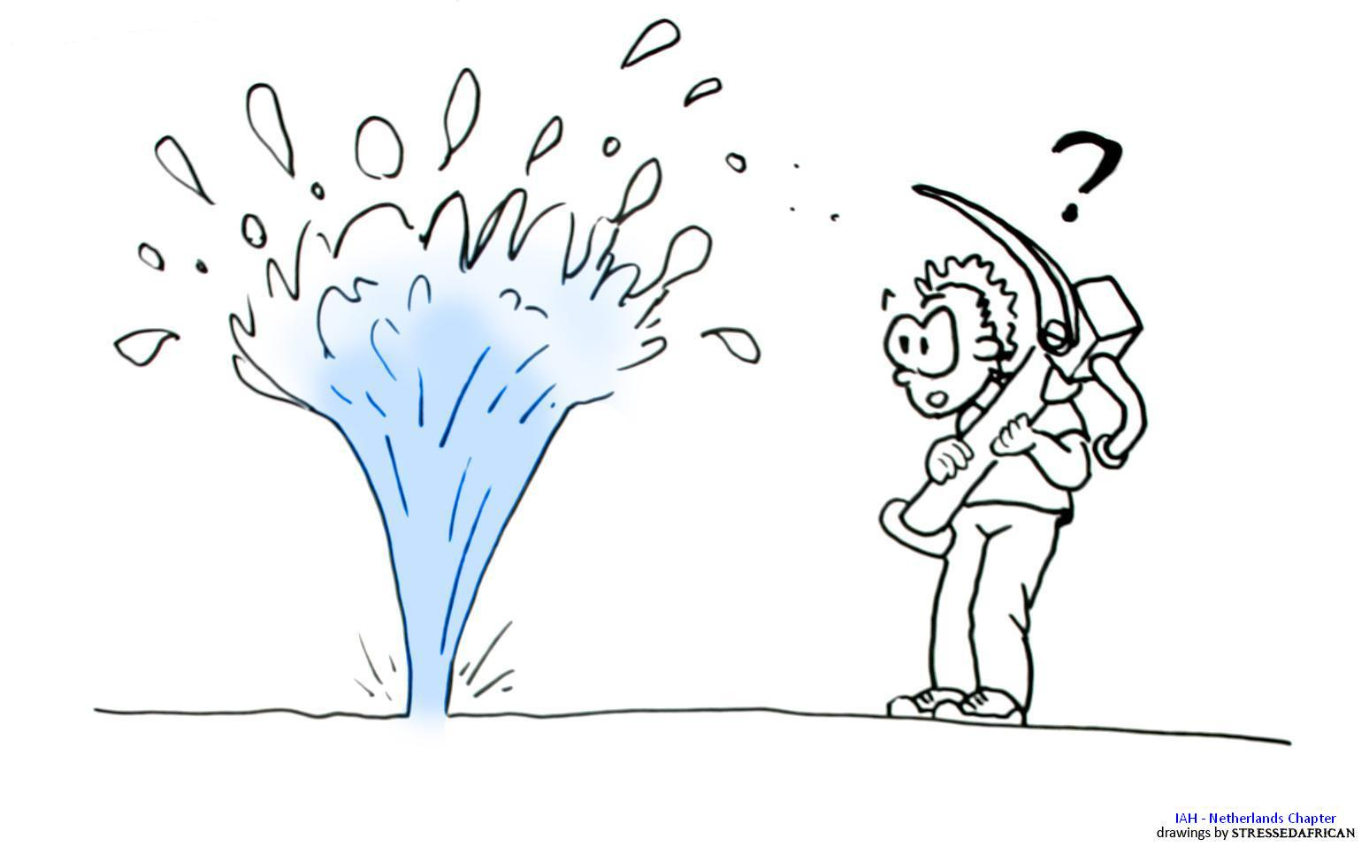
Take Aways
Natural Impediments: groundwater / hydrogeology is not visible, heterogeneous, and high uncertainty associated with groundwater supply development (no guarantees until a well has been drilled and tested!)
https://www.hydrology.nl/iahpublications/201-groundwater-cartoons.html

Slide 19
Take Aways
Specialized type of water project that requires involvement by the groundwater consultant and practitioners from start to finish.
Planning phase is crucial.
Typically, smaller water systems do not have budget compared to large municipalities – therefore an approach that emphasizes planning and holistic (team) approach will likely be more successful.

Slide 20
Jim Fyfe, BA.Sc.(Eng.)
jim@fwws.ca
(250) 248-0380
Ineke Kalwij, Ph.D., P.Eng.
ineke@oceanside-hydrogeology.ca
(604) 615-4932
https://oceanside-hydrogeology.ca/
Thank you for your attention!
Questions?

